Slide 1
DATA WAREHOUSE
UNIT 3

Slide 2
DATA WAREHOUSE……
A data warehouse is constructed by integrating data from multiple heterogeneous sources. It supports analytical reporting, structured and/or ad hoc queries and decision making. This tutorial adopts a step-by-step approach to explain all the necessary concepts of data warehousing.

Slide 3
INTRODUCTION
The term "Data Warehouse" was first coined by Bill Inmon in 1990.
According to Inmon, a data warehouse is a subject oriented, integrated, time-variant, and non-volatile collection of data. This data helps analysts to take informed dec
An operational database undergoes frequent changes on a daily basis on account of the transactions that take place. Suppose a business executive wants to analyze previous feedback on any data such as a product, a supplier, or any consumer data, then the executive will have no data available to analyze because the previous data has been updated due to transactions.isions in an organization.

Slide 4
BENEFITS OF DATA WAREHOUSE
A data warehouses provides us generalized and consolidated data in multidimensional view. Along with generalized and consolidated view of data, a data warehouses also provides us Online Analytical Processing (OLAP) tools. These tools help us in interactive and effective analysis of data in a multidimensional space. This analysis results in data generalization and data mining.
Data mining functions such as association, clustering, classification, prediction can be integrated with OLAP operations to enhance the interactive mining of knowledge at multiple level of abstraction. That's why data warehouse has now become an important platform for data analysis and online analytical processing

Slide 5
Understanding a Data Warehouse
A data warehouse is a database, which is kept separate from the organization's operational database.
There is no frequent updating done in a data warehouse.
It possesses consolidated historical data, which helps the organization to analyze its business.
A data warehouse helps executives to organize, understand, and use their data to take strategic decisions.
Data warehouse systems help in the integration of diversity of application systems.
A data warehouse system helps in consolidated historical data analysis.

Slide 6
Why a Data Warehouse is Separated from Operational Databases
A data warehouses is kept separate from operational databases due to the following reasons −
An operational database is constructed for well-known tasks and workloads such as searching particular records, indexing, etc. In contract, data warehouse queries are often complex and they present a general form of data.
Operational databases support concurrent processing of multiple transactions. Concurrency control and recovery mechanisms are required for operational databases to ensure robustness and consistency of the database.
An operational database query allows to read and modify operations, while an OLAP query needs only read only access of stored data.
An operational database maintains current data. On the other hand, a data warehouse maintains historical data.

Slide 7
Data Warehouse Features
Subject Oriented − A data warehouse is subject oriented because it provides information around a subject rather than the organization's ongoing operations. These subjects can be product, customers, suppliers, sales, revenue, etc. A data warehouse does not focus on the ongoing operations, rather it focuses on modelling and analysis of data for decision making.
Integrated − A data warehouse is constructed by integrating data from heterogeneous sources such as relational databases, flat files, etc. This integration enhances the effective analysis of data.
Time Variant − The data collected in a data warehouse is identified with a particular time period. The data in a data warehouse provides information from the historical point of view.
Non-volatile − Non-volatile means the previous data is not erased when new data is added to it. A data warehouse is kept separate from the operational database and therefore frequent changes in operational database is not reflected in the data warehouse.
Note − A data warehouse does not require transaction processing, recovery, and concurrency controls, because it is physically stored and separate from the operational database.

Slide 8
Data Warehouse Applications
As discussed before, a data warehouse helps business executives to organize, analyze, and use their data for decision making. A data warehouse serves as a sole part of a plan-execute-assess "closed-loop" feedback system for the enterprise management. Data warehouses are widely used in the following fields −
Financial services
Banking services
Consumer goods
Retail sectors
Controlled manufacturing

Slide 9
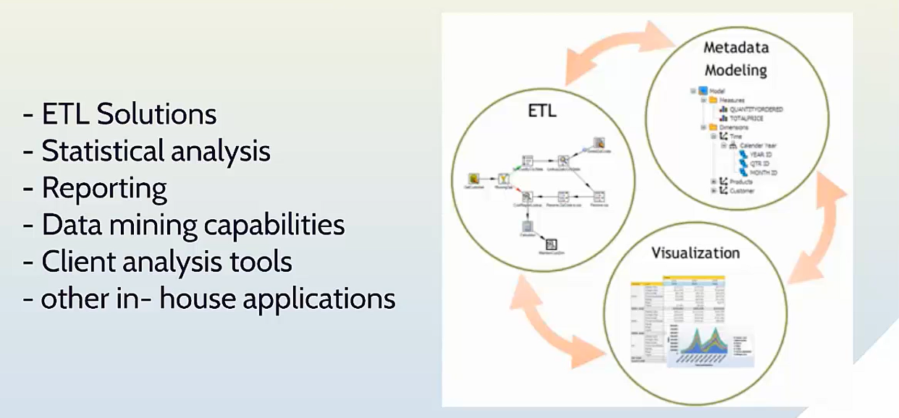
COMPONENTS OF DATA WAREHOUSE

Slide 10
Types of Data Warehouse
Information Processing − A data warehouse allows to process the data stored in it. The data can be processed by means of querying, basic statistical analysis, reporting using crosstabs, tables, charts, or graphs.
Analytical Processing − A data warehouse supports analytical processing of the information stored in it. The data can be analyzed by means of basic OLAP operations, including slice-and-dice, drill down, drill up, and pivoting.
Data Mining − Data mining supports knowledge discovery by finding hidden patterns and associations, constructing analytical models, performing classification and prediction. These mining results can be presented using the visualization tools.

Slide 11
Sr.No. | Data Warehouse (OLAP) | Operational Database(OLTP)
1 | It involves historical processing of information. | It involves day-to-day processing.
2 | OLAP systems are used by knowledge workers such as executives, managers, and analysts. | OLTP systems are used by clerks, DBAs, or database professionals.
3 | It is used to analyze the business. | It is used to run the business.
4 | It focuses on Information out. | It focuses on Data in.
5 | It is based on Star Schema, Snowflake Schema, and Fact Constellation Schema. | It is based on Entity Relationship Model.
6 | It focuses on Information out. | It is application oriented.
7 | It contains historical data. | It contains current data.
8 | It provides summarized and consolidated data. | It provides primitive and highly detailed data.
9 | It provides summarized and multidimensional view of data. | It provides detailed and flat relational view of data.
10 | The number of users is in hundreds. | The number of users is in thousands.
11 | The number of records accessed is in millions. | The number of records accessed is in tens.
12 | The database size is from 100GB to 100 TB. | The database size is from 100 MB to 100 GB.
13 | These are highly flexible. | It provides high performance.

Slide 12
Functions of Data Warehouse Tools and Utilities
The following are the functions of data warehouse tools and utilities −
Data Extraction − Involves gathering data from multiple heterogeneous sources.
Data Cleaning − Involves finding and correcting the errors in data.
Data Transformation − Involves converting the data from legacy format to warehouse format.
Data Loading − Involves sorting, summarizing, consolidating, checking integrity, and building indices and partitions.
Refreshing − Involves updating from data sources to warehouse.
Note − Data cleaning and data transformation are important steps in improving the quality of data and data mining results.

Slide 13
Integrating Heterogeneous Databases
1) Query-Driven Approach
This is the traditional approach to integrate heterogeneous databases. This approach was used to build wrappers and integrators on top of multiple heterogeneous databases. These integrators are also known as mediators.
Process of Query-Driven Approach
When a query is issued to a client side, a metadata dictionary translates the query into an appropriate form for individual heterogeneous sites involved.
Now these queries are mapped and sent to the local query processor.
The results from heterogeneous sites are integrated into a global answer set.
Disadvantages
Query-driven approach needs complex integration and filtering processes.
This approach is very inefficient.
It is very expensive for frequent queries.
This approach is also very expensive for queries that require aggregations.

Slide 14
2) Update-Driven Approach
This is an alternative to the traditional approach. Today's data warehouse systems follow update-driven approach rather than the traditional approach discussed earlier. In update-driven approach, the information from multiple heterogeneous sources are integrated in advance and are stored in a warehouse. This information is available for direct querying and analysis.
Advantages
This approach has the following advantages −
This approach provide high performance.
The data is copied, processed, integrated, annotated, summarized and restructured in semantic data store in advance.
Query processing does not require an interface to process data at local sources.

Slide 15
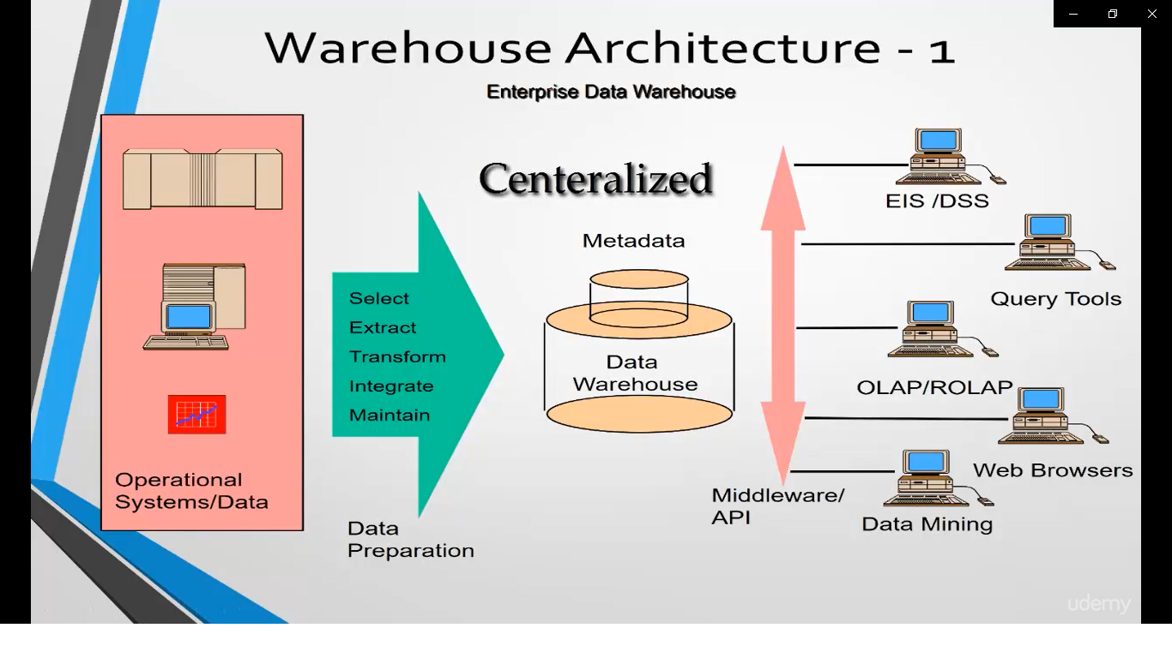
Architecture Of DATA WAREHOUSE

Slide 16
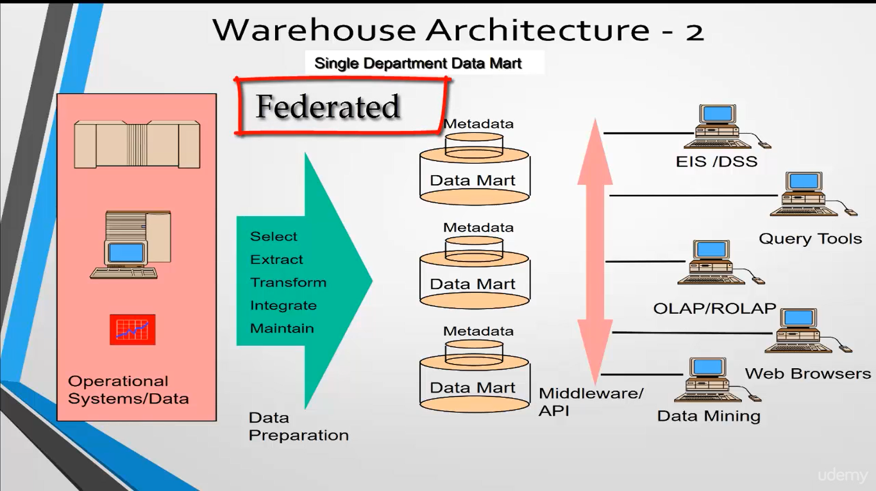

Slide 17
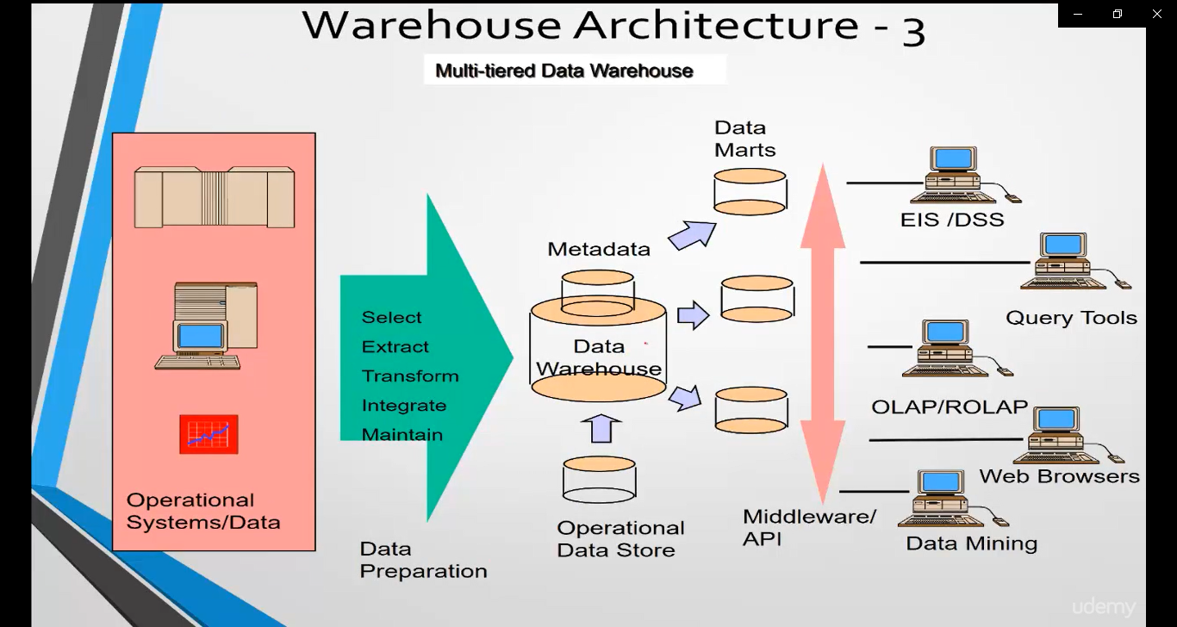

Slide 18
Generalized Architecture of Data Warehouse
Business Analysis Framework
The business analyst get the information from the data warehouses to measure the performance and make critical adjustments in order to win over other business holders in the market. Having a data warehouse offers the following advantages −
Since a data warehouse can gather information quickly and efficiently, it can enhance business productivity.
A data warehouse provides us a consistent view of customers and items, hence, it helps us manage customer relationship.
A data warehouse also helps in bringing down the costs by tracking trends, patterns over a long period in a consistent and reliable manner.
To design an effective and efficient data warehouse, we need to understand and analyze the business needs and construct a business analysis framework. Each person has different views regarding the design of a data warehouse. These views are as follows −
The top-down view − This view allows the selection of relevant information needed for a data warehouse.
The data source view − This view presents the information being captured, stored, and managed by the operational system.
The data warehouse view − This view includes the fact tables and dimension tables. It represents the information stored inside the data warehouse.
The business query view − It is the view of the data from the viewpoint of the end-user.

Slide 19
Three-Tier Data Warehouse Architecture
Bottom Tier − The bottom tier of the architecture is the data warehouse database server. It is the relational database system. We use the back end tools and utilities to feed data into the bottom tier. These back end tools and utilities perform the Extract, Clean, Load, and refresh functions.
Middle Tier − In the middle tier, we have the OLAP Server that can be implemented in either of the following ways.
By Relational OLAP (ROLAP), which is an extended relational database management system. The ROLAP maps the operations on multidimensional data to standard relational operations.
By Multidimensional OLAP (MOLAP) model, which directly implements the multidimensional data and operations.
Top-Tier − This tier is the front-end client layer. This layer holds the query tools and reporting tools, analysis tools and data mining tools.

Slide 20
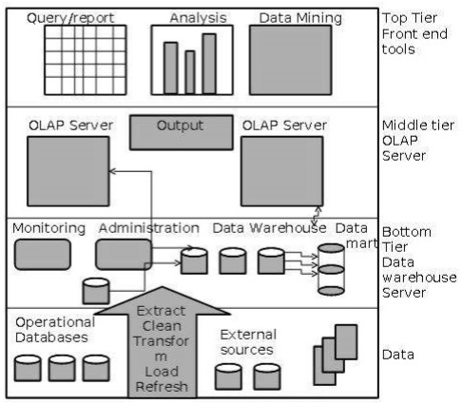

Slide 21
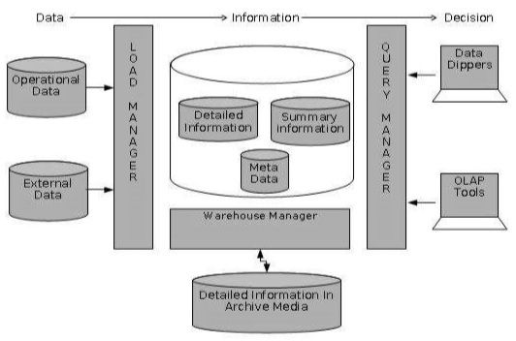
Components of Data Warehouse Architecture

Slide 22
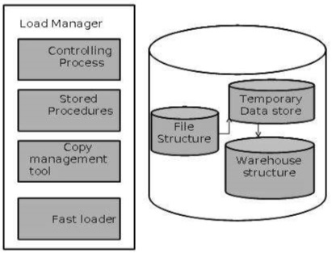
1) Load Manager
This component performs the operations required to extract and load process.
The size and complexity of the load manager varies between specific solutions from one data warehouse to other.
Load Manager Architecture
The load manager performs the following functions −
Extract the data from source system.
Fast Load the extracted data into temporary data store.
Perform simple transformations into structure similar to the one in the data warehouse.

Slide 23
A. Extract Data from Source
The data is extracted from the operational databases or the external information providers. Gateways is the application programs that are used to extract data. It is supported by underlying DBMS and allows client program to generate SQL to be executed at a server. Open Database Connection(ODBC), Java Database Connection (JDBC), are examples of gateway.
B. Fast Load
In order to minimize the total load window the data need to be loaded into the warehouse in the fastest possible time.
The transformations affects the speed of data processing.
It is more effective to load the data into relational database prior to applying transformations and checks.
Gateway technology proves to be not suitable, since they tend not be performant when large data volumes are involved.
C. Simple Transformations
While loading it may be required to perform simple transformations. After this has been completed we are in position to do the complex checks. Suppose we are loading the EPOS sales transaction we need to perform the following checks:
Strip out all the columns that are not required within the warehouse.
Convert all the values to required data types.

Slide 24
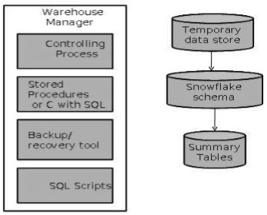
2) Warehouse Manager
A warehouse manager is responsible for the warehouse management process. It consists of third-party system software, C programs, and shell scripts.
The size and complexity of warehouse managers varies between specific solutions.
Warehouse Manager Architecture
A warehouse manager includes the following −
The controlling process
Stored procedures or C with SQL
Backup/Recovery tool
SQL Scripts

Slide 25
Operations Performed by Warehouse Manager
A warehouse manager analyzes the data to perform consistency and referential integrity checks.
Creates indexes, business views, partition views against the base data.
Generates new aggregations and updates existing aggregations. Generates normalizations.
Transforms and merges the source data into the published data warehouse.
Backup the data in the data warehouse.
Archives the data that has reached the end of its captured life.
Note − A warehouse Manager also analyzes query profiles to determine index and aggregations are appropriate.

Slide 26
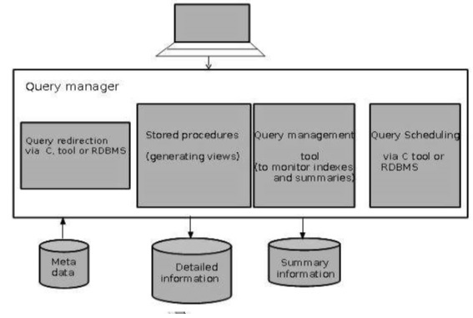
3) Query Manager
Query manager is responsible for directing the queries to the suitable tables.
By directing the queries to appropriate tables, the speed of querying and response generation can be increased.
Query manager is responsible for scheduling the execution of the queries posed by the user.
Query Manager Architecture
The following screenshot shows the architecture of a query manager. It includes the following:
Query redirection via C tool or RDBMS
Stored procedures
Query management tool
Query scheduling via C tool or RDBMS
Query scheduling via third-party software

Slide 27
4) Detailed Information
Detailed information is not kept online, rather it is aggregated to the next level of detail and then archived to tape.
The detailed information part of data warehouse keeps the detailed information in the starflake schema.
Detailed information is loaded into the data warehouse to supplement the aggregated data.

Slide 28
5) Summary Information
Summary Information is a part of data warehouse that stores predefined aggregations. These aggregations are generated by the warehouse manager. Summary Information must be treated as transient. It changes on-the-go in order to respond to the changing query profiles.
The points to note about summary information are as follows −
Summary information speeds up the performance of common queries.
It increases the operational cost.
It needs to be updated whenever new data is loaded into the data warehouse.
It may not have been backed up, since it can be generated fresh from the detailed information.

Slide 29
Metadata
Metadata is simply defined as data about data. The data that are used to represent other data is known as metadata. For example, the index of a book serves as a metadata for the contents in the book. In other words, we can say that metadata is the summarized data that leads us to the detailed data.
In terms of data warehouse, we can define metadata as following −
Metadata is a road-map to data warehouse.
Metadata in data warehouse defines the warehouse objects.
Metadata acts as a directory. This directory helps the decision support system to locate the contents of a data warehouse.

Slide 30
Categories of Metadata
Metadata can be broadly categorized into three categories −
Business Metadata − It has the data ownership information, business definition, and changing policies.
Technical Metadata − It includes database system names, table and column names and sizes, data types and allowed values. Technical metadata also includes structural information such as primary and foreign key attributes and indices.
Operational Metadata − It includes currency of data and data lineage. Currency of data means whether the data is active, archived, or purged. Lineage of data means the history of data migrated and transformation applied on it.

Slide 31
Role of Metadata
Metadata acts as a directory.
This directory helps the decision support system to locate the contents of the data warehouse.
Metadata helps in decision support system for mapping of data when data is transformed from operational environment to data warehouse environment.
Metadata helps in summarization between current detailed data and highly summarized data.
Metadata also helps in summarization between lightly detailed data and highly summarized data.
Metadata is used for query tools.
Metadata is used in extraction and cleansing tools.
Metadata is used in reporting tools.
Metadata is used in transformation tools.
Metadata plays an important role in loading functions.

Slide 32
Metadata Repository
Metadata repository is an integral part of a data warehouse system. It contains the following metadata −
Business metadata − It contains the data ownership information, business definition, and changing policies.
Operational metadata − It includes currency of data and data lineage. Currency of data refers to the data being active, archived, or purged. Lineage of data means history of data migrated and transformation applied on it.
Data for mapping from operational environment to data warehouse − It metadata includes source databases and their contents, data extraction, data partition, cleaning, transformation rules, data refresh and purging rules.
The algorithms for summarization − It includes dimension algorithms, data on granularity, aggregation, summarizing, etc.

Slide 33
WHAT IS DATA CUBE?
A data cube allows data to be modeled and viewed in multiple dimensions. It is defined by dimensions and facts.
Dimensions are the perspectives or entities with respect to which an organization wants to keep records.
Facts are numerical measures. It is the quantities by which we want to analyze relationships between dimensions.

Slide 34
Illustration of Data Cube
Suppose a company wants to keep track of sales records with the help of sales data warehouse with respect to time, item, branch, and location. These dimensions allow to keep track of monthly sales and at which branch the items were sold. There is a table associated with each dimension. This table is known as dimension table. For example, "item" dimension table may have attributes such as item_name, item_type, and item_brand.

Slide 35
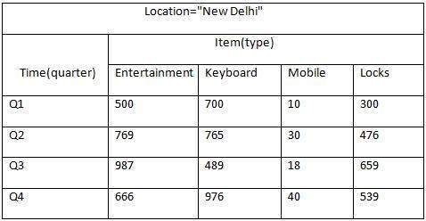
The following table represents the 2-D view of Sales Data for a company with respect to time, item, and location dimension
But here in this 2-D table, we have records with respect to time and item only. The sales for New Delhi are shown with respect to time, and item dimensions according to type of items sold. If we want to view the sales data with one more dimension, say, the location dimension, then the 3-D view would be useful.

Slide 36
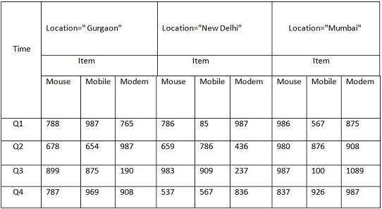
The 3-D view of the sales data with respect to time, item, and location is shown in the table below −

Slide 37

The above 3-D table can be represented as 3-D data cube as shown in the following figure −

Slide 38
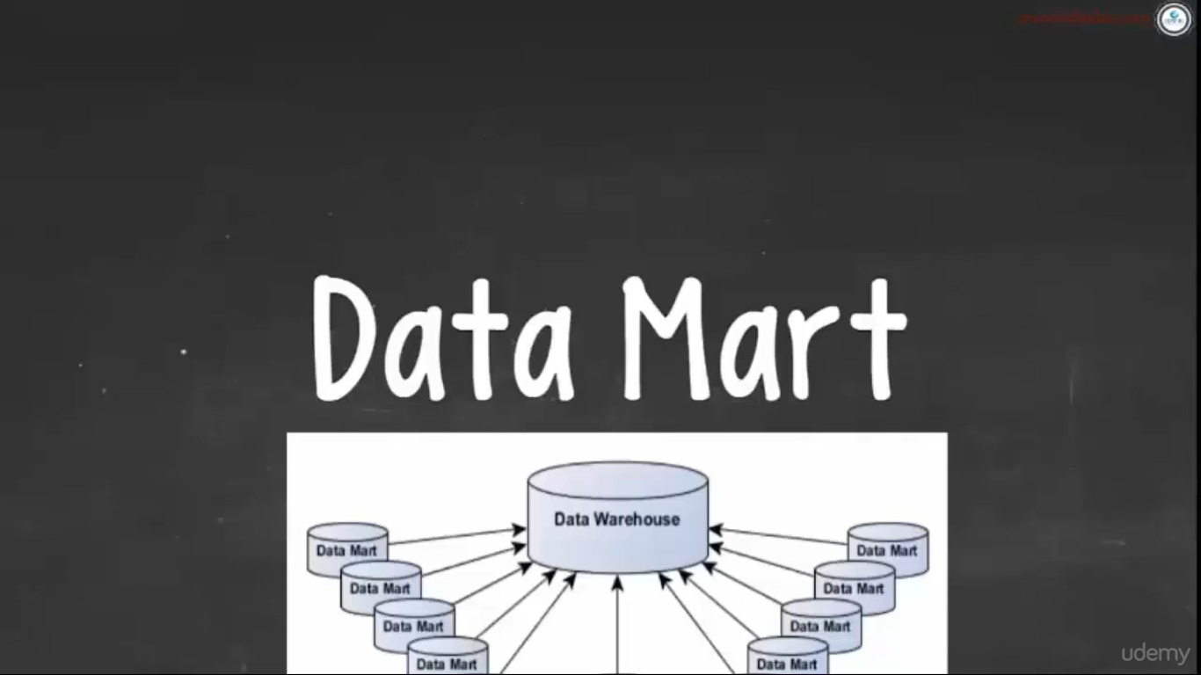

Slide 39
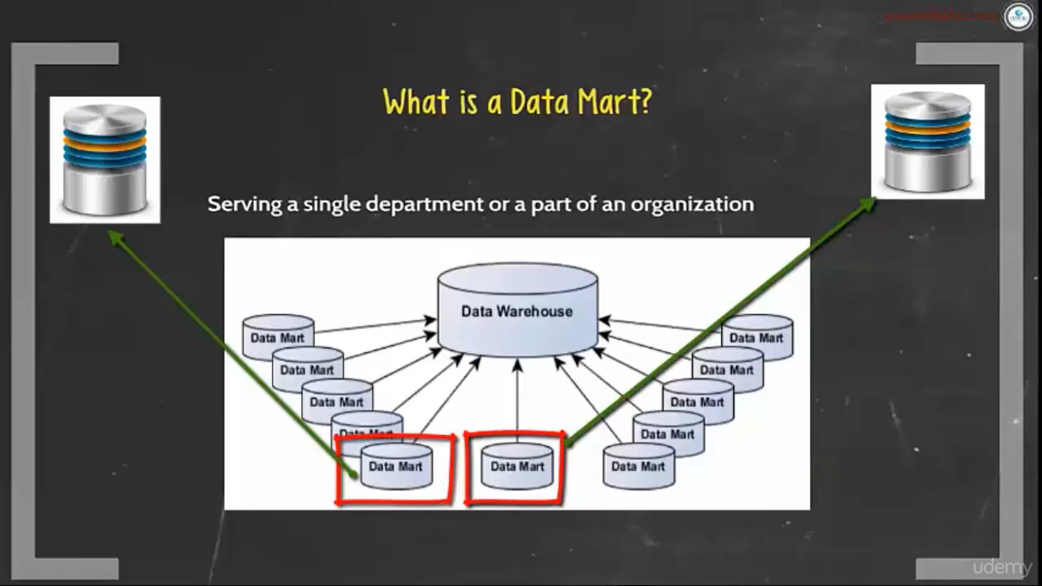

Slide 40
Data Mart
Data marts contain a subset of organization-wide data that is valuable to specific groups of people in an organization. In other words, a data mart contains only those data that is specific to a particular group. For example, the marketing data mart may contain only data related to items, customers, and sales. Data marts are confined to subjects.
Points to Remember About Data Marts
Windows-based or Unix/Linux-based servers are used to implement data marts. They are implemented on low-cost servers.
The implementation cycle of a data mart is measured in short periods of time, i.e., in weeks rather than months or years.
The life cycle of data marts may be complex in the long run, if their planning and design are not organization-wide.
Data marts are small in size.
Data marts are customized by department.
The source of a data mart is departmentally structured data warehouse.
Data marts are flexible.

Slide 41
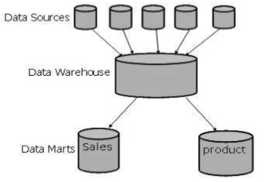

Slide 42
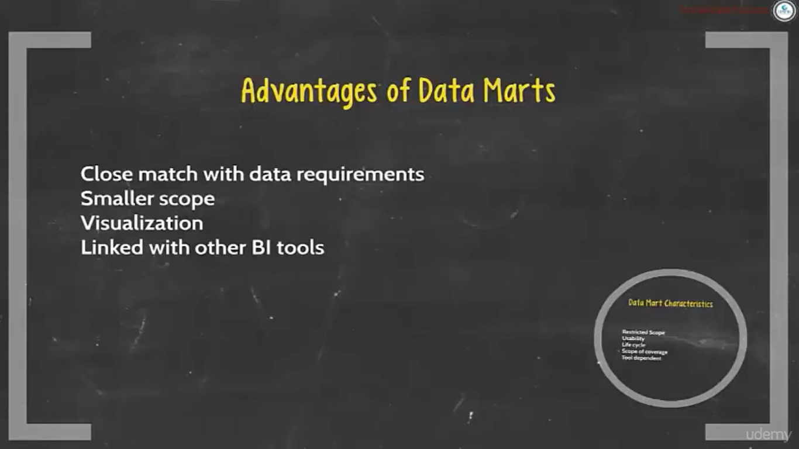

Slide 43
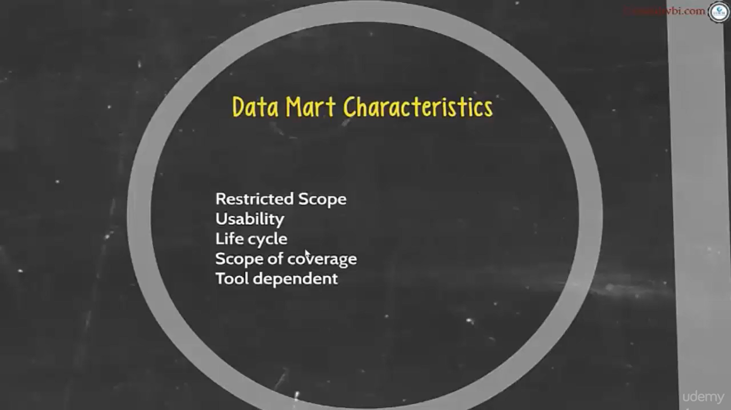

Slide 44
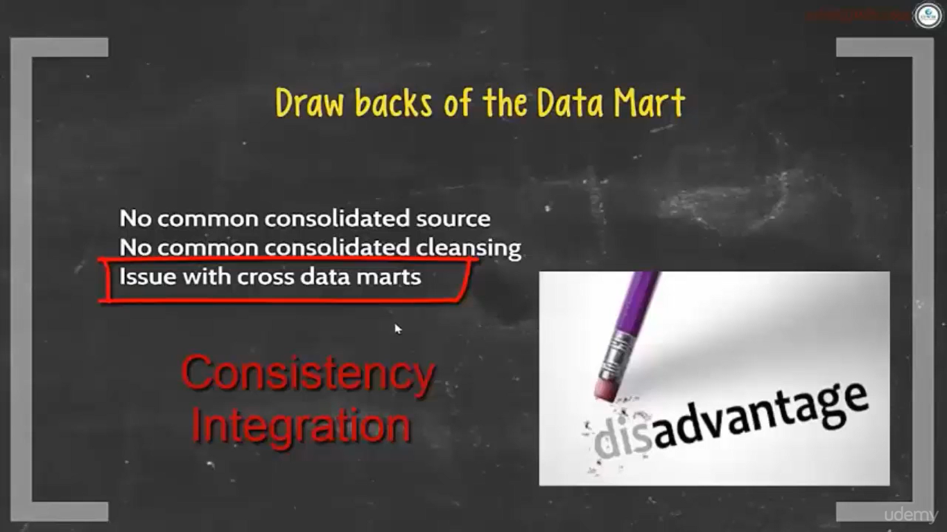

Slide 45
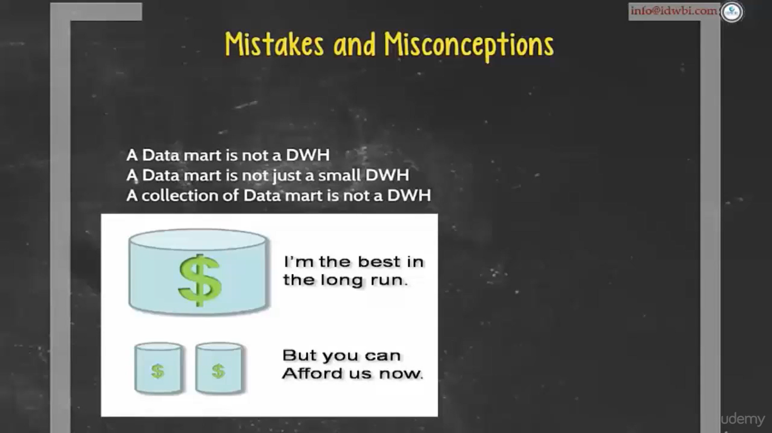

Slide 46
Virtual Warehouse
The view over an operational data warehouse is known as virtual warehouse.
It is easy to build a virtual warehouse.
Building a virtual warehouse requires excess capacity on operational database servers.

Slide 47
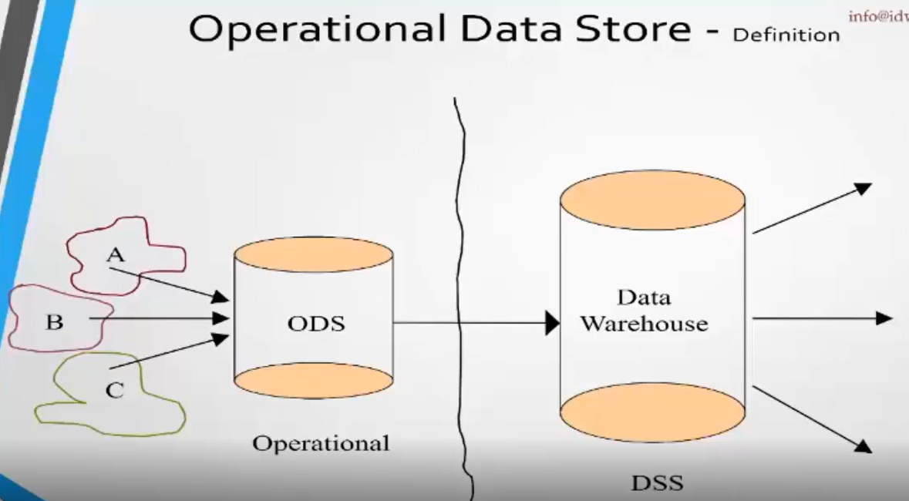

Slide 48
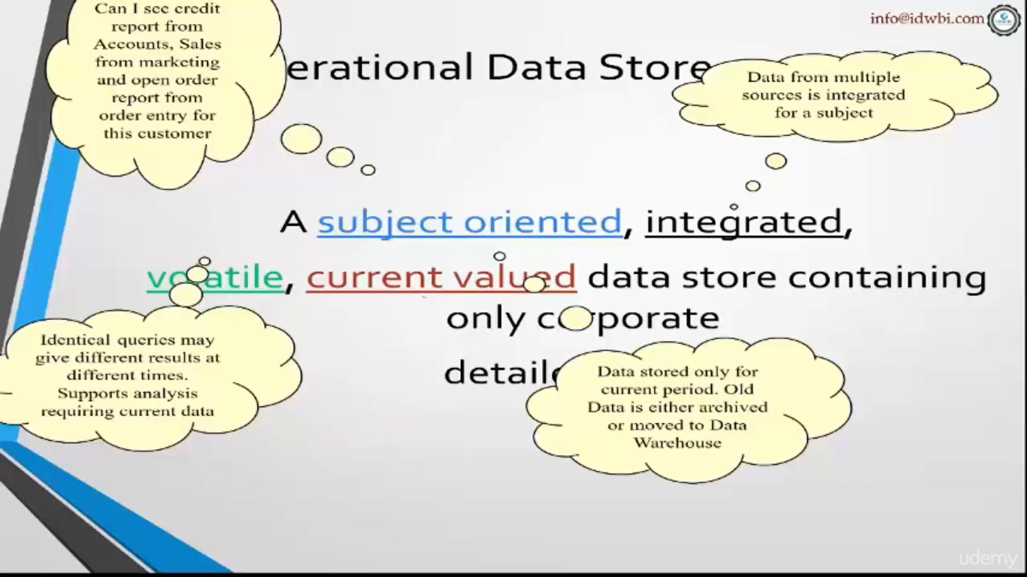

Slide 49
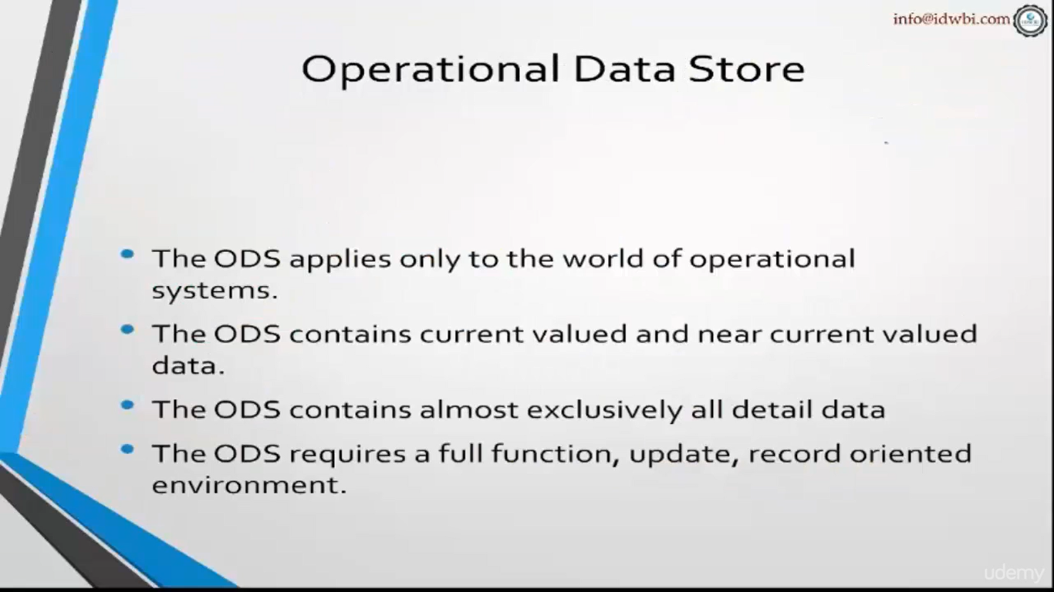

Slide 50
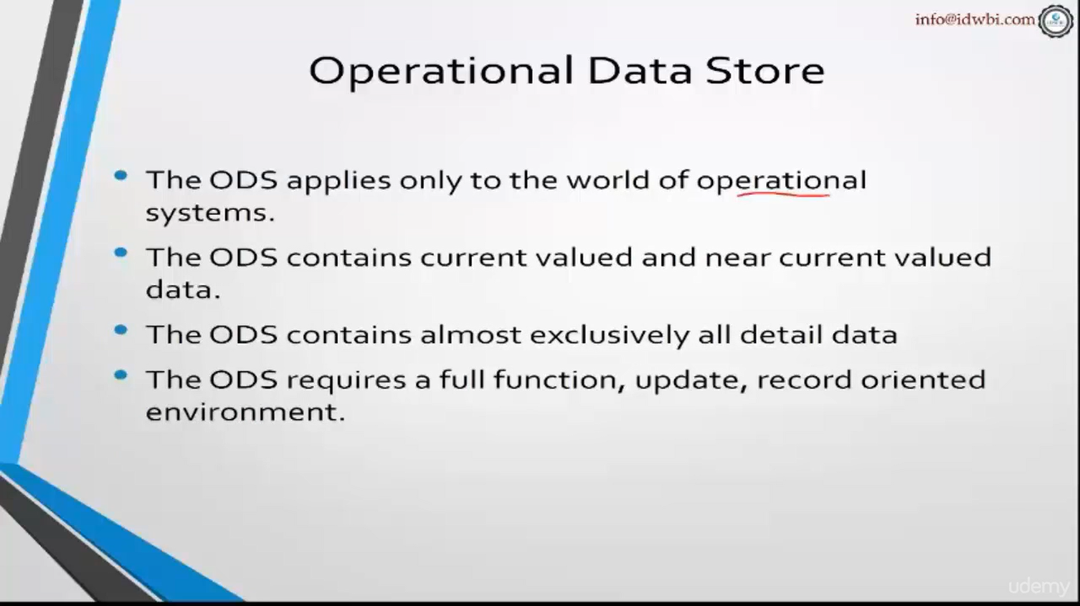

Slide 51
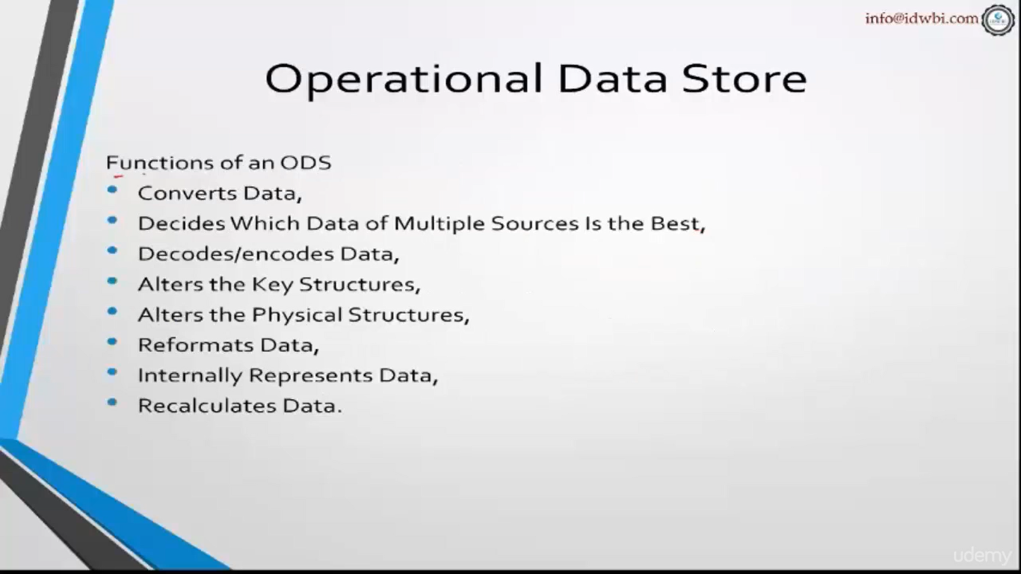

Slide 52
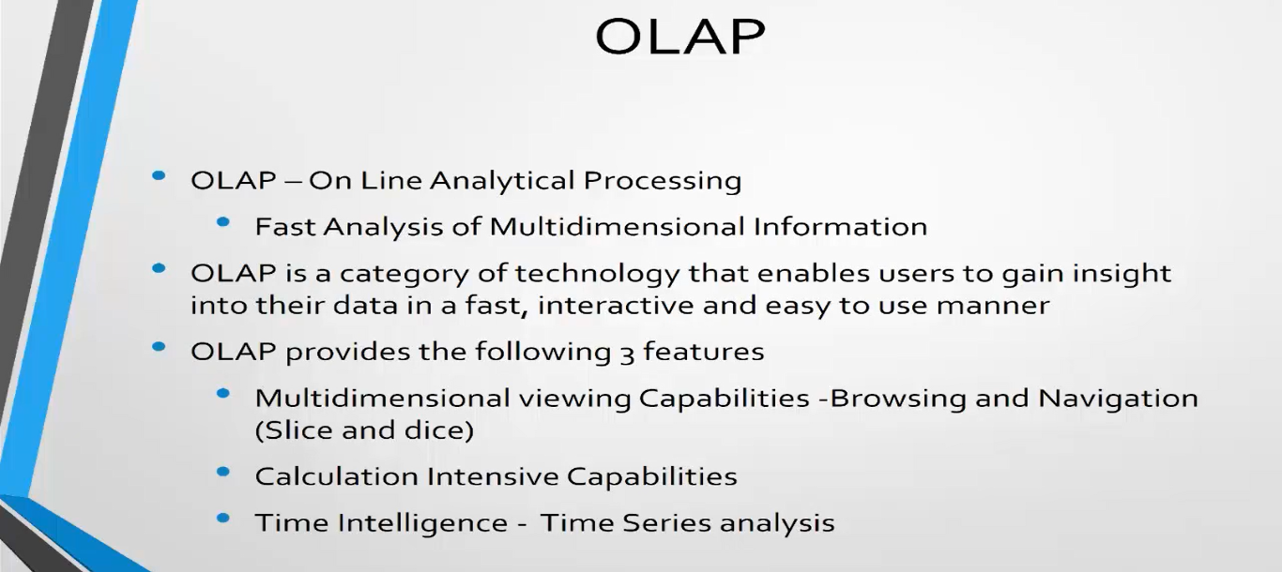
Online Analytical Processing Server (OLAP) is based on the multidimensional data model. It allows managers, and analysts to get an insight of the information through fast, consistent, and interactive access to information

Slide 53
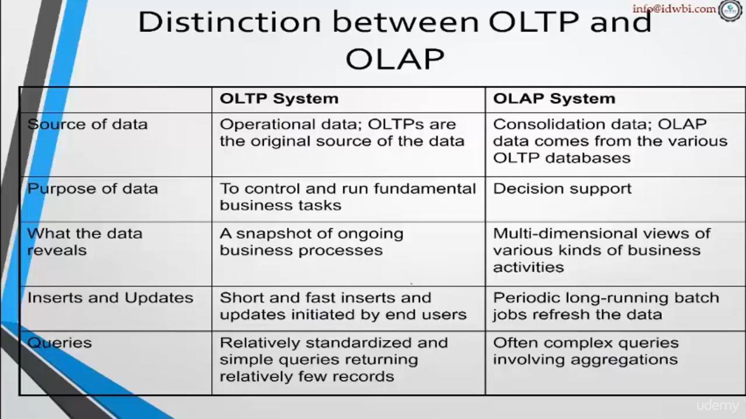

Slide 54
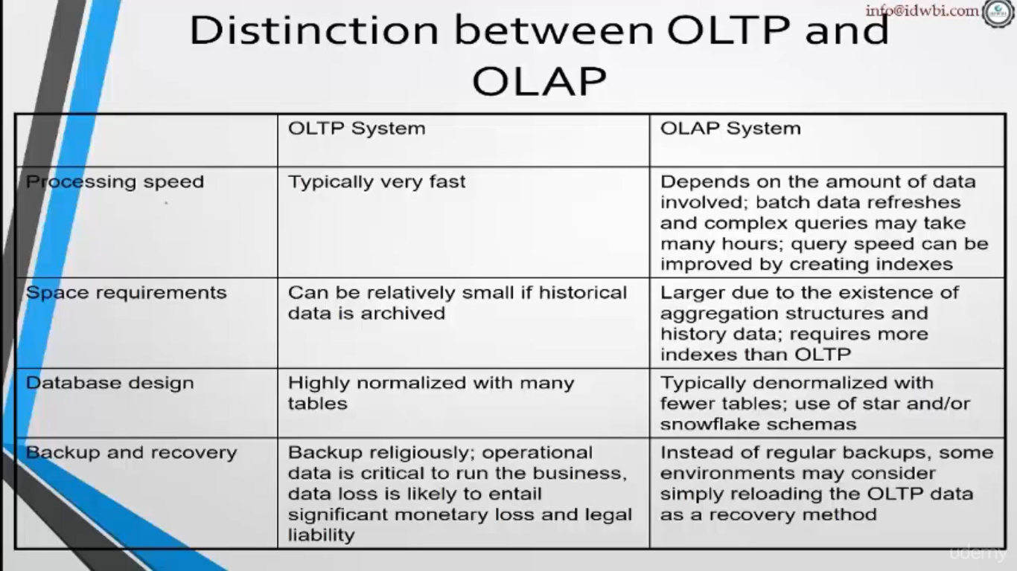

Slide 55
Types of OLAP Servers
We have four types of OLAP servers −
Relational OLAP (ROLAP)
Multidimensional OLAP (MOLAP)
Hybrid OLAP (HOLAP)
Specialized SQL Servers

Slide 56
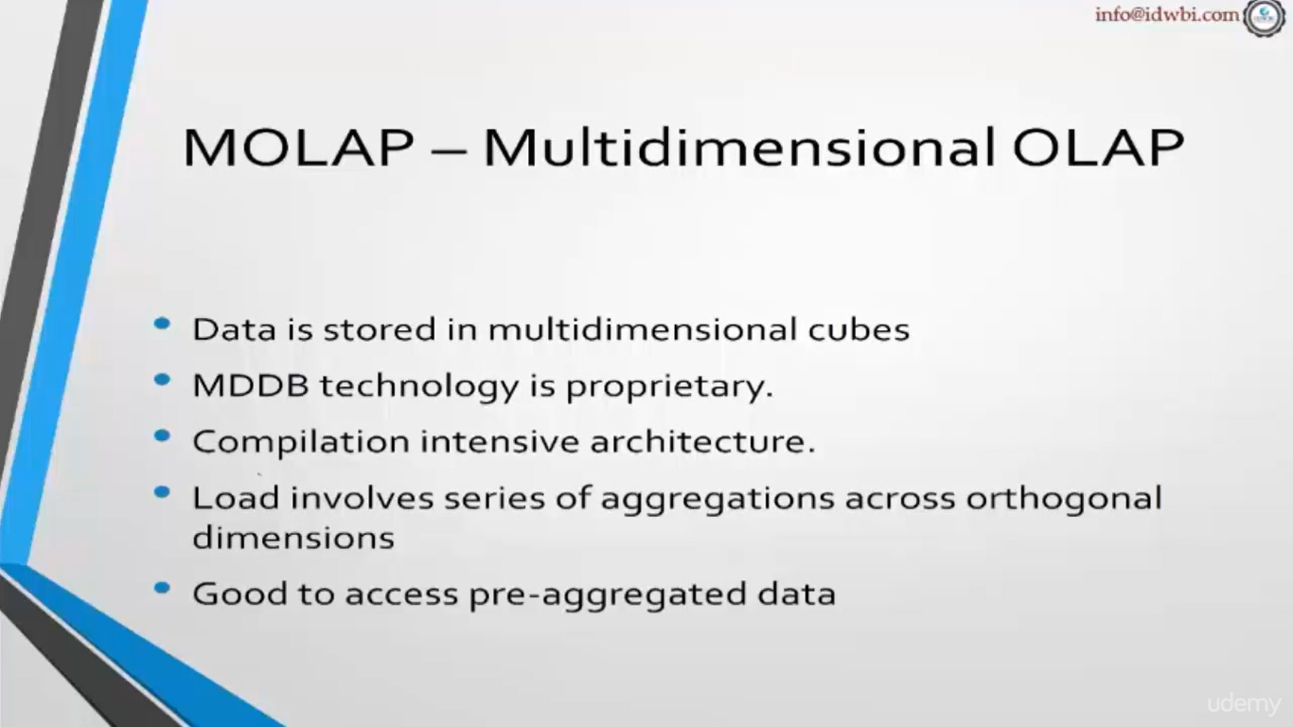

Slide 57
Multidimensional OLAP
MOLAP uses array-based multidimensional storage engines for multidimensional views of data.
With multidimensional data stores, the storage utilization may be low if the data set is sparse.
Therefore, many MOLAP server use two levels of data storage representation to handle dense and sparse data sets.

Slide 58
Multidimensional Data
Sales volume as a function of product, month, and region
Dimensions: Product, Location, Time
Hierarchical summarization paths
Region
Industry Region Year
Category Country Quarter
Product City Month Week
Office Day
Product
Month

Slide 59
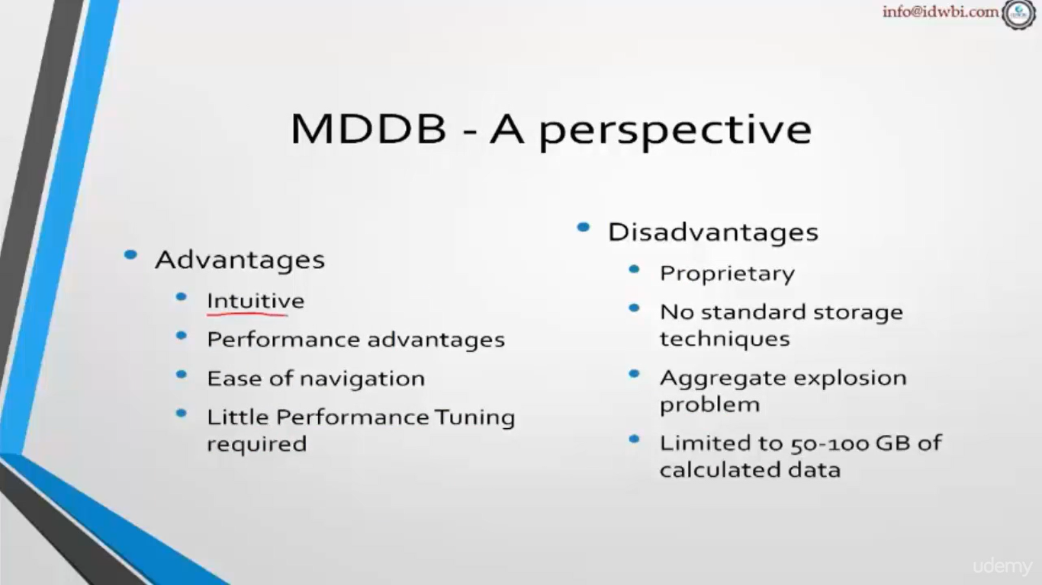

Slide 60
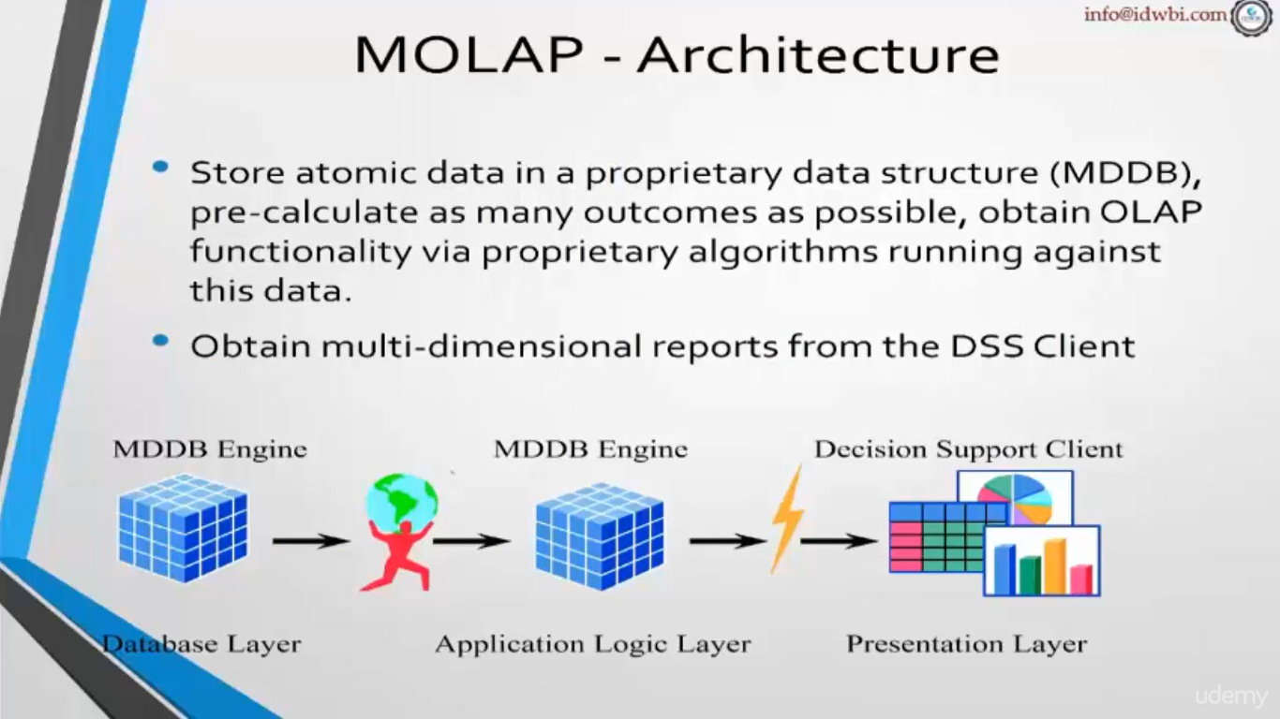

Slide 61
Relational OLAP
ROLAP servers are placed between relational back-end server and client front-end tools. To store and manage warehouse data, ROLAP uses relational or extended-relational DBMS.
ROLAP includes the following −
Implementation of aggregation navigation logic.
Optimization for each DBMS back end.
Additional tools and services

Slide 62
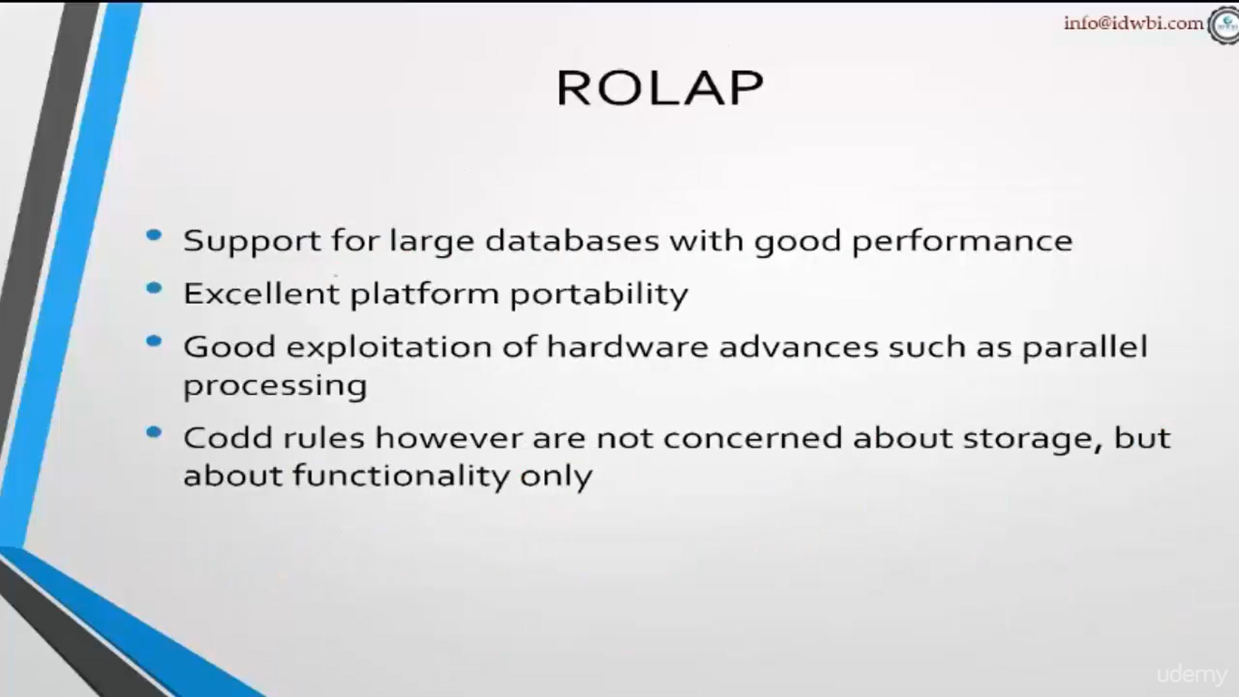

Slide 63
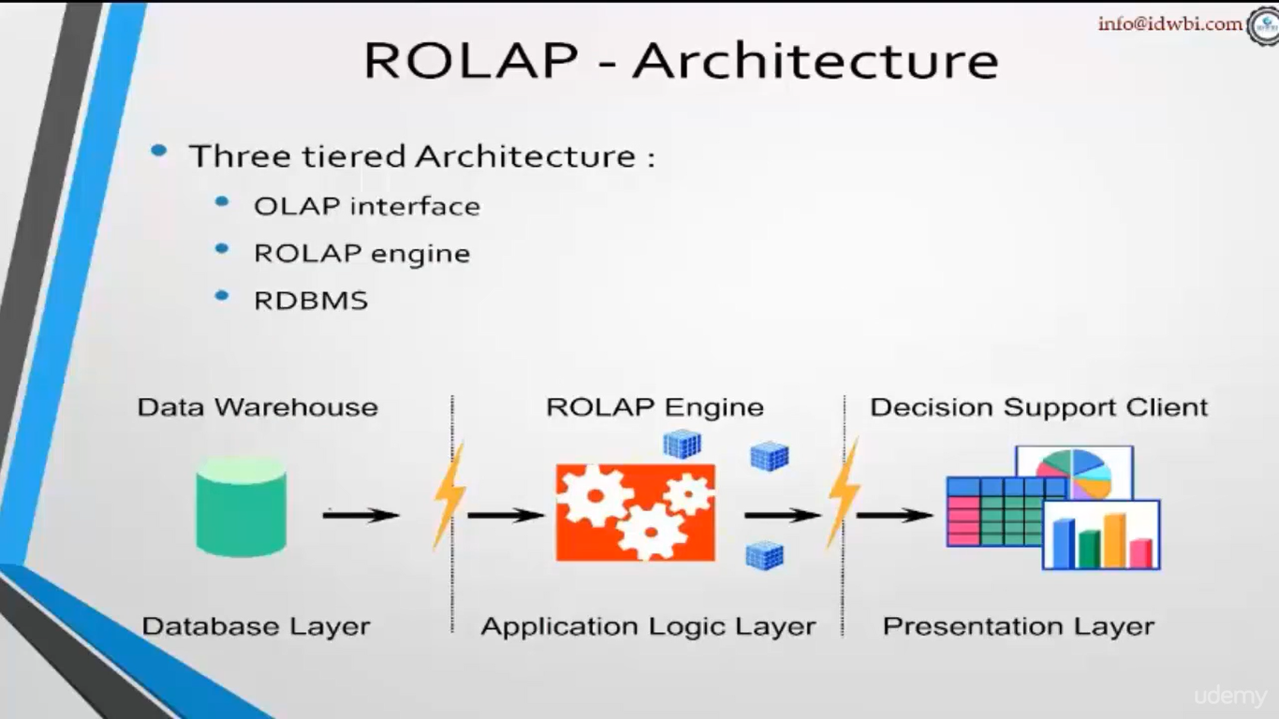

Slide 64
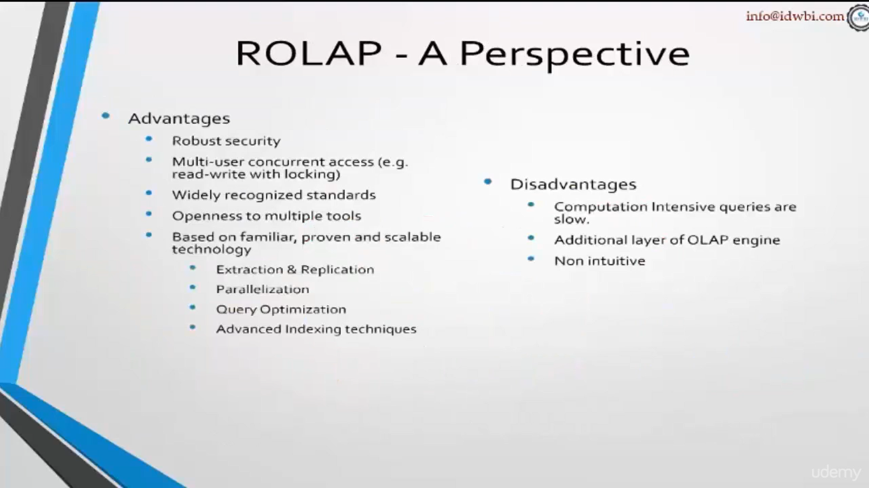

Slide 65
Hybrid OLAP
Hybrid OLAP is a combination of both ROLAP and MOLAP.
It offers higher scalability of ROLAP and faster computation of MOLAP.
HOLAP servers allows to store the large data volumes of detailed information.
The aggregations are stored separately in MOLAP store

Slide 66
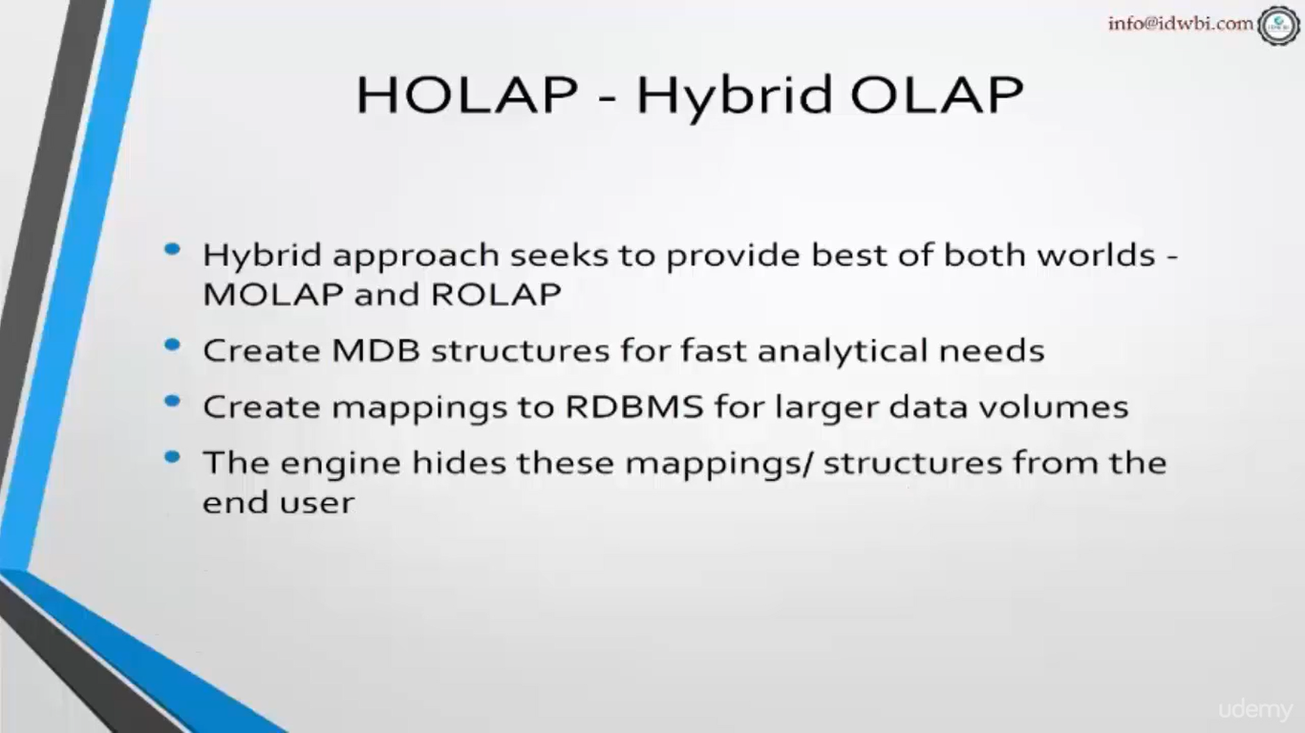

Slide 67
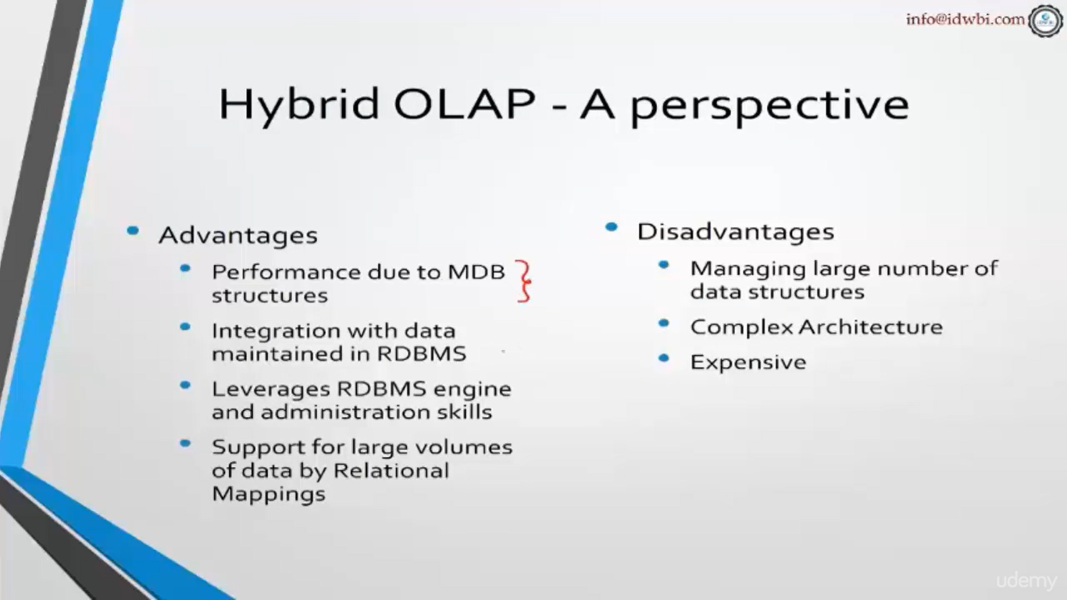

Slide 68
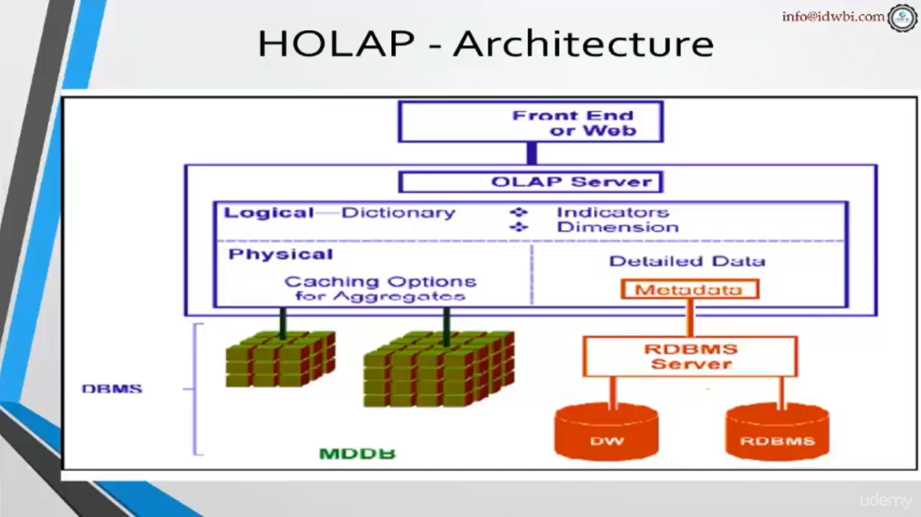

Slide 69
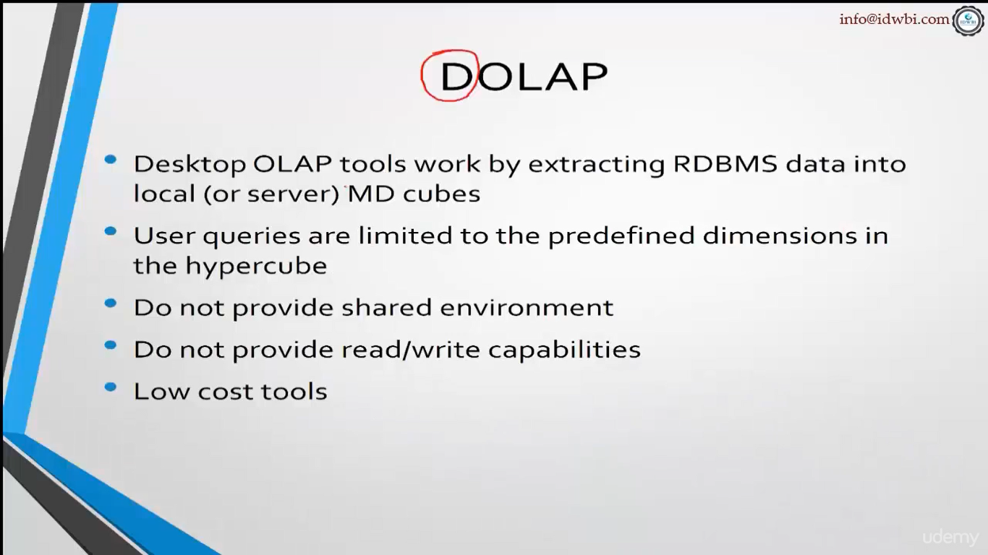

Slide 70
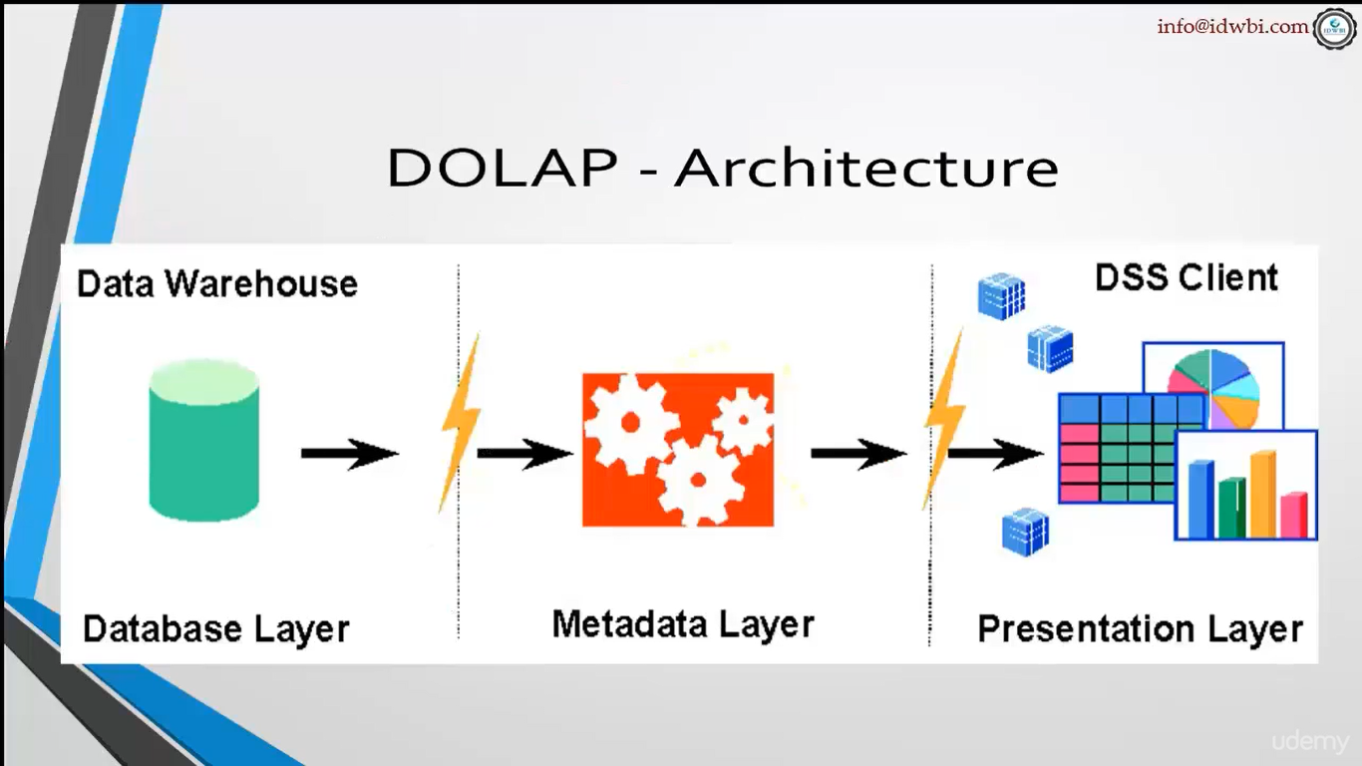

Slide 71
Typical OLAP Operations
Since OLAP servers are based on multidimensional view of data, we will discuss OLAP operations in multidimensional data.
Roll up (drill-up): summarize data
by climbing up hierarchy or by dimension reduction
Drill down (roll down): reverse of roll-up
from higher level summary to lower level summary or detailed data, or introducing new dimensions
Slice and dice: project and select
Pivot (rotate):
reorient the cube, visualization, 3D to series of 2D planes
Other operations
drill across: involving (across) more than one fact table
drill through: through the bottom level of the cube to its back-end relational tables (using SQL)

Slide 72
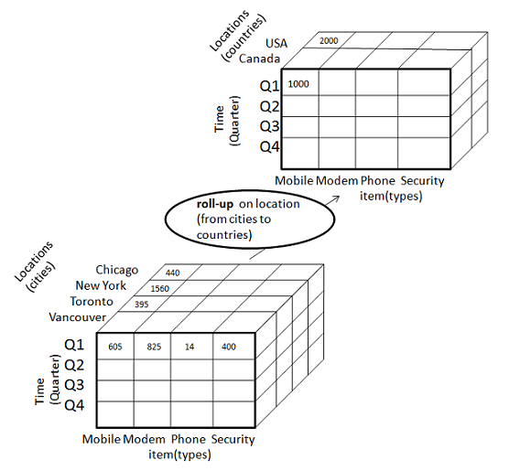
1) Roll-up
Roll-up performs aggregation on a data cube in any of the following ways −
By climbing up a concept hierarchy for a dimension
By dimension reduction
Roll-up is performed by climbing up a concept hierarchy for the dimension location.
Initially the concept hierarchy was "street < city < province < country".
On rolling up, the data is aggregated by ascending the location hierarchy from the level of city to the level of country.
The data is grouped into cities rather than countries.
When roll-up is performed, one or more dimensions from the data cube are removed.

Slide 73
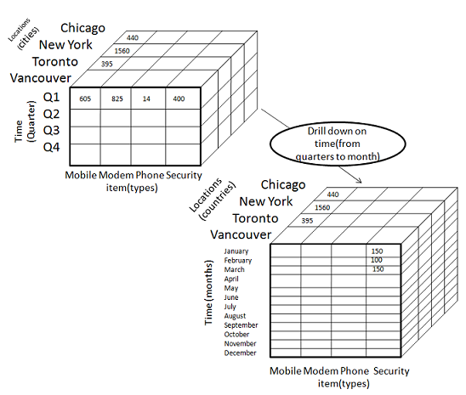
2) Drill-down
Drill-down is the reverse operation of roll-up. It is performed by either of the following ways −
By stepping down a concept hierarchy for a dimension
By introducing a new dimension.
Drill-down is performed by stepping down a concept hierarchy for the dimension time.
Initially the concept hierarchy was "day < month < quarter < year."
On drilling down, the time dimension is descended from the level of quarter to the level of month.
When drill-down is performed, one or more dimensions from the data cube are added.
It navigates the data from less detailed data to highly detailed data.

Slide 74
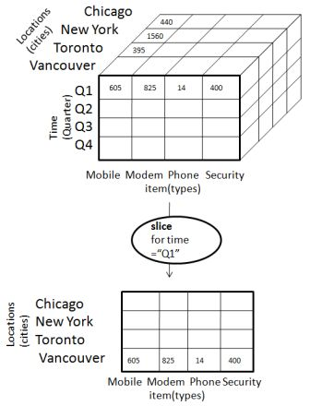
3) Slice
The slice operation selects one particular dimension from a given cube and provides a new sub-cube. Consider the following diagram that shows how slice works.
Here Slice is performed for the dimension "time" using the criterion time = "Q1".
It will form a new sub-cube by selecting one or more dimensions.

Slide 75
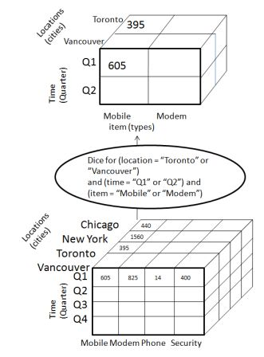
3) Dice
Dice selects two or more dimensions from a given cube and provides a new sub-cube. Consider the following diagram that shows the dice operation.
The dice operation on the cube based on the following selection criteria involves three dimensions.
(location = "Toronto" or "Vancouver")
(time = "Q1" or "Q2")
(item =" Mobile" or "Modem")

Slide 76
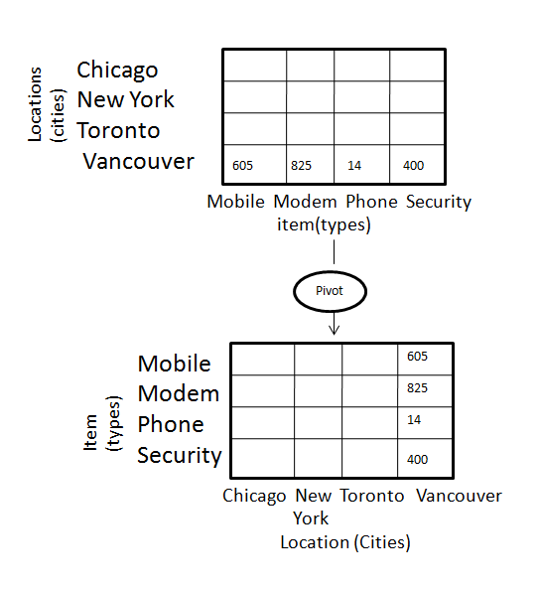
5) Pivot
The pivot operation is also known as rotation.
It rotates the data axes in view in order to provide an alternative presentation of data.

Slide 77
DATA MODELLING
The entity-relationship data model is commonly used in the design of relational databases, where a database schema consists of a set of entities and the relationships between them. Such a data model is appropriate for on-line transaction processing.
The data warehouse requires concise, subject –oriented schema that facilitates OLAP.
Data warehouses and OLAP tools are based on a multidimensional data model. This model views data in the form of a data cube

Slide 78
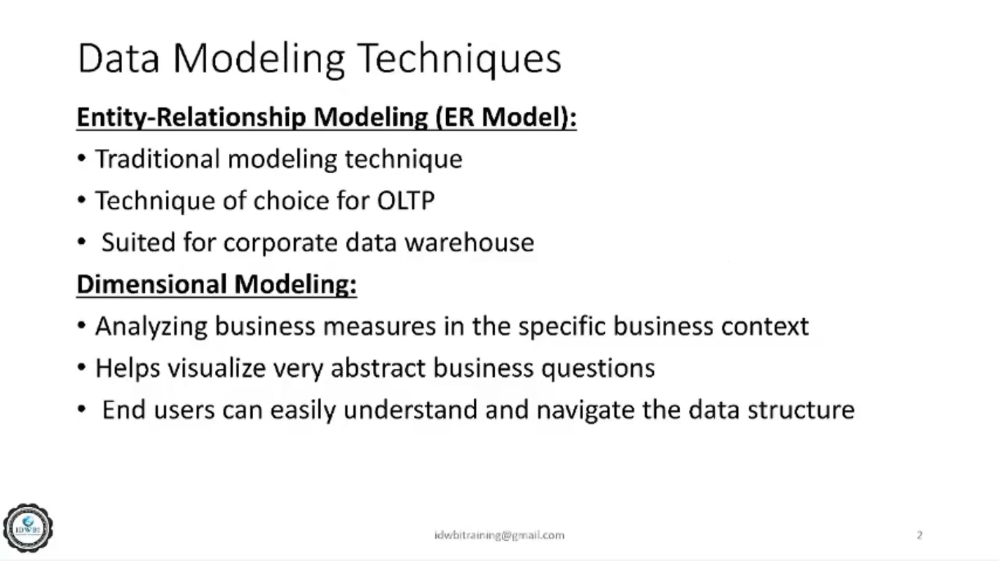
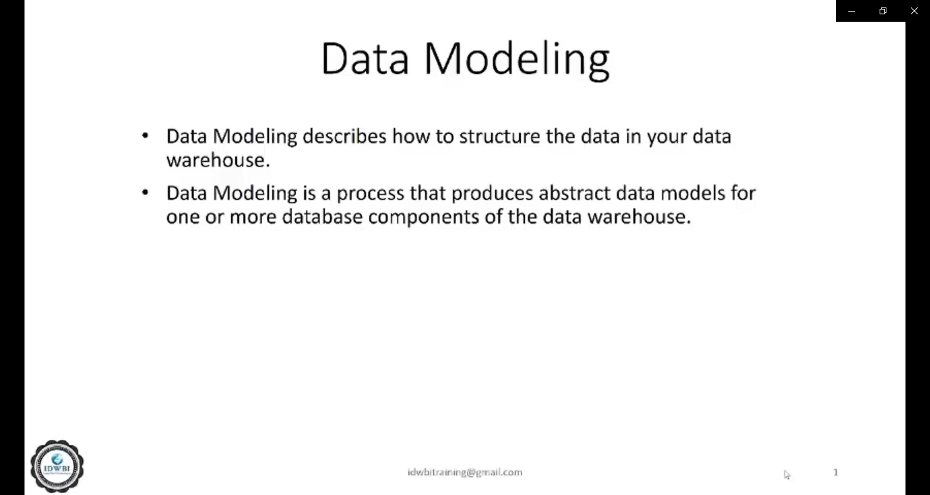

Slide 79
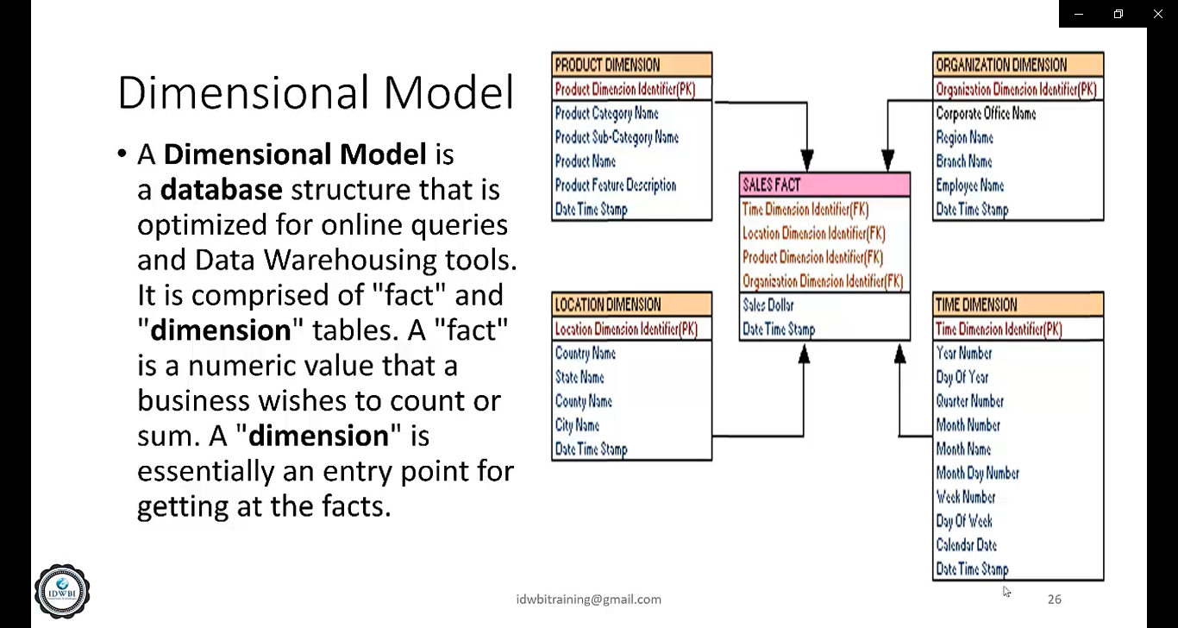

Slide 80
Benefits OF Dimensional Modelling
Fast Data Retrieval
Better Understandability
Extensibility

Slide 81
What is Dimension?????
Dimension is an Object in the Data warehouse world which provides the means to slice and dice the data and it is an element which is similar to categorical data.
Example: Location, Date, Product
These are the dimensions which could be applied on sales recept or sales report
The task of dimension is FILTERING, GROUPING and LABELING

Slide 82
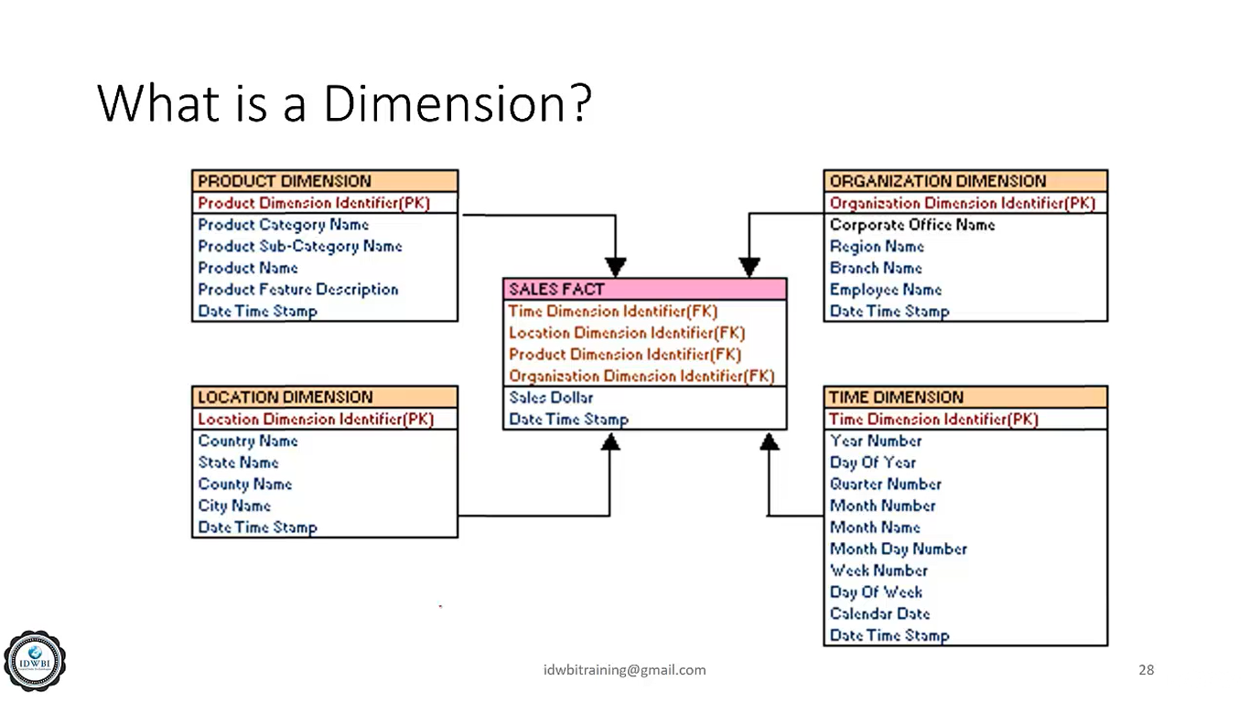

Slide 83
What is FACT?????
Fact table are the foundation of data warehouse
They contain the fundamental measurements of the enterprise
They are the ultimate target for most of the data warehouse queries
They are defined by the grave or the lowest level
They provide additive values by which the facts may be defined
It Example: sales dollar
It is a measurable value with all descriptive contents connected to it

Slide 84
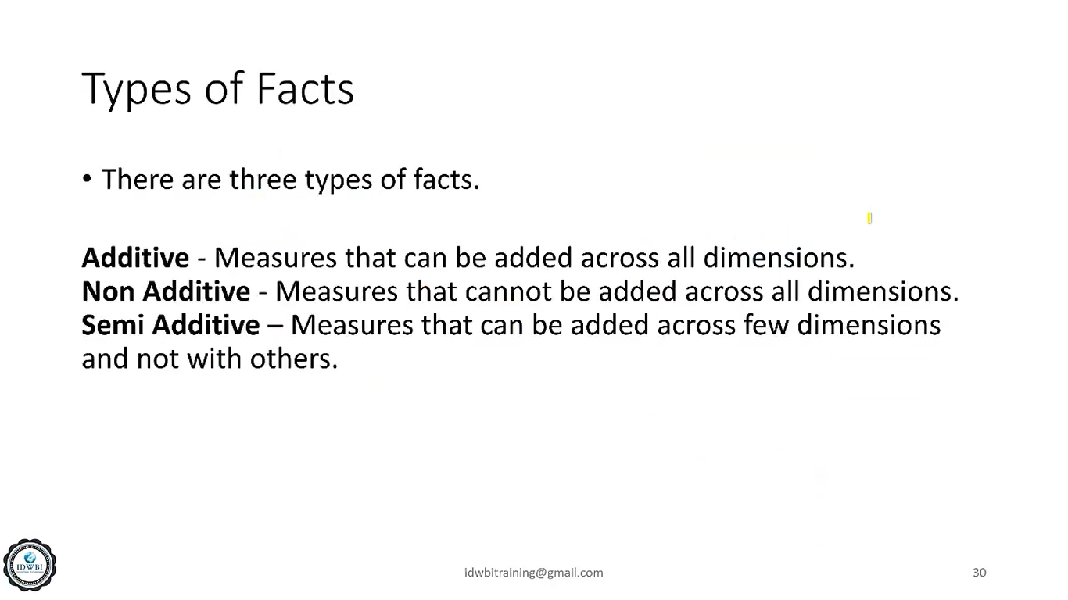

Slide 85
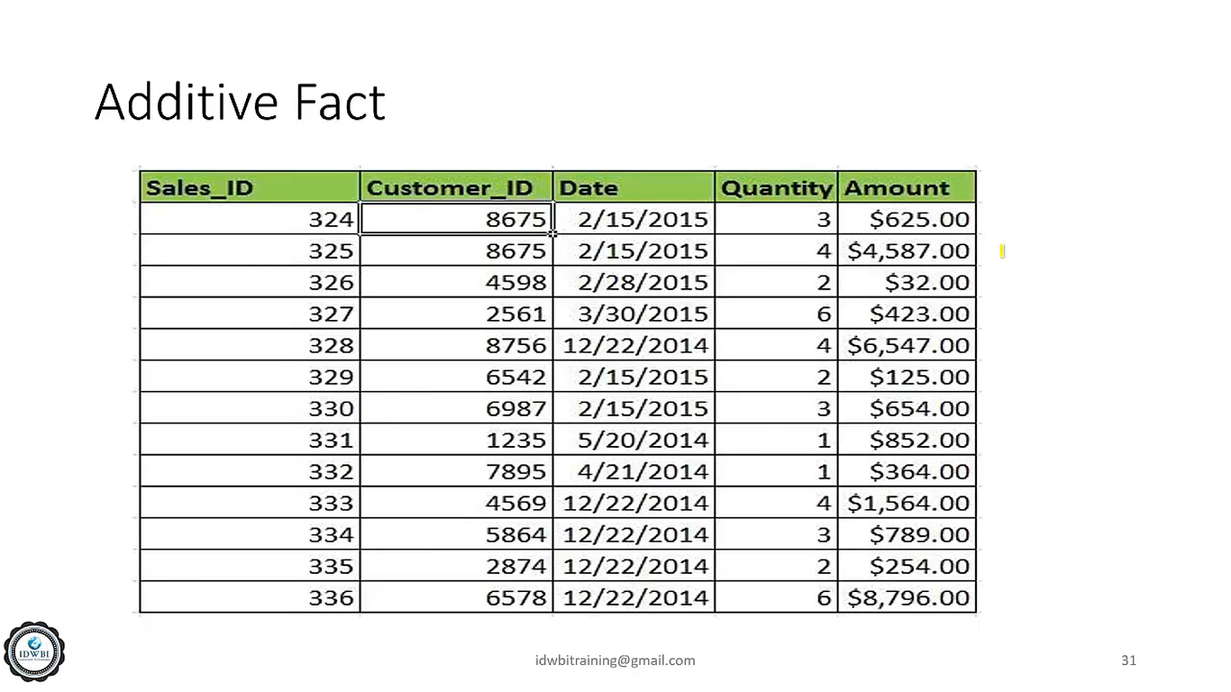
ADDITIVE FACT
An additive fact is the one which has the transaction date giving the info o different dimension of each transaction and the measurement
Here dimension: is Sales id, Customer id and Date
Measurement is: Quantity, Amount
All the records can be grouped by sales date or the customer id and the quantity and amount can be aggregated

Slide 86
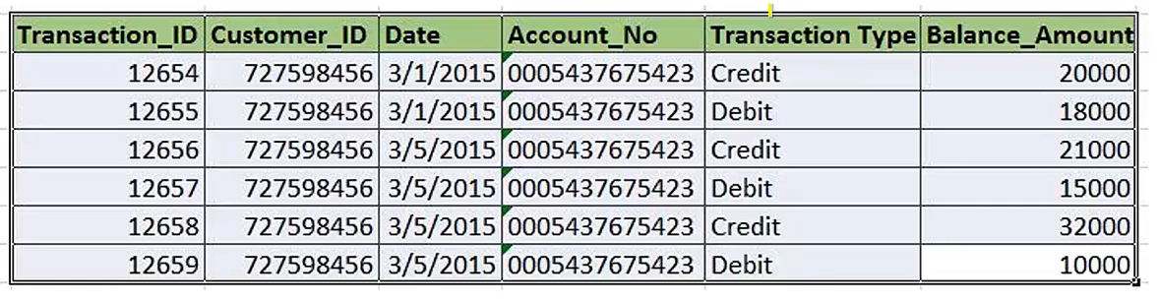
SEMI_ADDITIVE FACTS
EXAMPLE OF TRANSACTIONS MADE IN BANK ACCOUNT

Slide 87
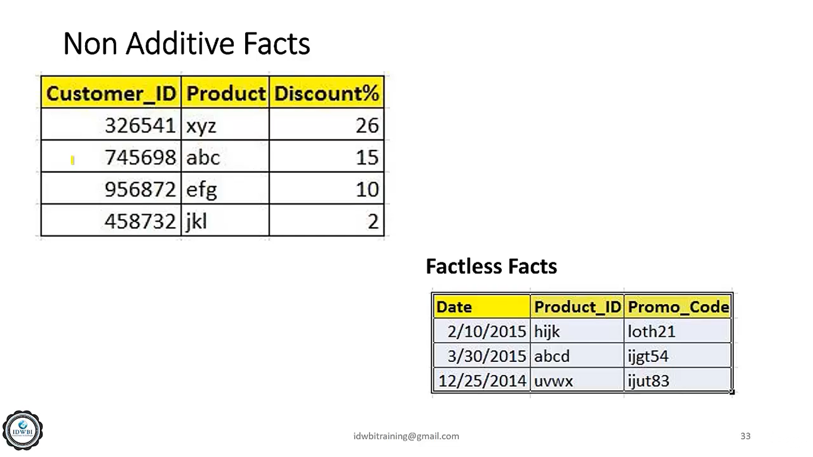

Slide 88


Slide 89
STAR SCHEMA
Each dimension in a star schema is represented with only one-dimension table.
This dimension table contains the set of attributes.
The following diagram shows the sales data of a company with respect to the four dimensions, namely time, item, branch, and location.
There is a fact table at the center. It contains the keys to each of four dimensions.
The fact table also contains the attributes, namely dollars sold and units sold.

Slide 90


Slide 91
Example of Star Schema
time
time_key
day
day_of_the_week
month
quarter
year
item
item_key
item_name
brand
type
supplier_type
Sales Fact Table
time_key
item_key
branch_key
branch
location
location_key
branch_key
branch_name
branch_type
location_key
street
city
state_or_province
country
units_sold
dollars_sold
avg_sales
Measures

Slide 92
It is extension to star schema
Improvement in query performance due to minimised disk performance and joins minor lookup tables
Disadv: Mor number of tables need to be maintained
Some dimension tables in the Snowflake schema are normalized.
The normalization splits up the data into additional tables.
Unlike Star schema, the dimensions table in a snowflake schema are normalized. For example, the item dimension table in star schema is normalized and split into two dimension tables, namely item and supplier table.
Now the item dimension table contains the attributes item_key, item_name, type, brand, and supplier-key.
The supplier key is linked to the supplier dimension table. The supplier dimension table contains the attributes supplier_key and supplier_type.

Slide 93


Slide 94
Example of Snowflake Schema
time
item
time_key
day
day_of_the_week
month
quarter
year
item_key
item_name
brand
type
supplier_key
supplier
Sales Fact Table
supplier_key
supplier_type
time_key
item_key
branch_key
branch
location
location_key
location_key
street
city_key
branch_key
branch_name
branch_type
units_sold
dollars_sold
city
city_key
city
state_or_province
country
avg_sales
Measures

Slide 95
Fact Constellation Schema
Multiple fact tables sharing common dimensions
A fact constellation has multiple fact tables. It is also known as galaxy schema.
The following diagram shows two fact tables, namely sales and delivery.

Slide 96


Slide 97
Example of Fact Constellation
time
time_key
day
day_of_the_week
month
quarter
year
item
Shipping Fact Table
item_key
item_name
brand
type
supplier_type
Sales Fact Table
time_key
time_key
item_key
shipper_key
item_key
branch_key
from_location
branch
location_key
location
to_location
branch_key
branch_name
branch_type
units_sold
location_key
street
city
province_or_state
country
dollars_cost
dollars_sold
units_shipped
avg_sales
shipper
Measures
shipper_key
shipper_name
location_key
shipper_type

Slide 98


Slide 99
Data Warehousing - Security
The objective of a data warehouse is to make large amounts of data easily accessible to the users, hence allowing the users to extract information about the business as a whole.
But we know that there could be some security restrictions applied on the data that can be an obstacle for accessing the information.
If the analyst has a restricted view of data, then it is impossible to capture a complete picture of the trends within the business.

Slide 100
Security Requirements
Adding security features affect the performance of the data warehouse, therefore it is important to determine the security requirements as early as possible. It is difficult to add security features after the data warehouse has gone live.
During the design phase of the data warehouse, we should keep in mind what data sources may be added later and what would be the impact of adding those data sources. We should consider the following possibilities during the design phase.
Whether the new data sources will require new security and/or audit restrictions to be implemented?
Whether the new users added who have restricted access to data that is already generally available?
This situation arises when the future users and the data sources are not well known. In such a situation, we need to use the knowledge of business and the objective of data warehouse to know likely requirements.
The following activities get affected by security measures −
User access
Data load
Data movement
Query generation

Slide 101
1) User Access
We need to first classify the data and then classify the users on the basis of the data they can access. In other words, the users are classified according to the data they can access.
Data Classification
The following two approaches can be used to classify the data −
Data can be classified according to its sensitivity. Highly-sensitive data is classified as highly restricted and less-sensitive data is classified as less restrictive.
Data can also be classified according to the job function. This restriction allows only specific users to view particular data. Here we restrict the users to view only that part of the data in which they are interested and are responsible for.
There are some issues in the second approach. To understand, let's have an example. Suppose you are building the data warehouse for a bank. Consider that the data being stored in the data warehouse is the transaction data for all the accounts. The question here is, who is allowed to see the transaction data. The solution lies in classifying the data according to the function.
B. User classification
The following approaches can be used to classify the users −
Users can be classified as per the hierarchy of users in an organization, i.e., users can be classified by departments, sections, groups, and so on.
Users can also be classified according to their role, with people grouped across departments based on their role.

Slide 102
2) Audit Requirements
Auditing is a subset of security, a costly activity. Auditing can cause heavy overheads on the system. To complete an audit in time, we require more hardware and therefore, it is recommended that wherever possible, auditing should be switched off. Audit requirements can be categorized as follows −
Connections
Disconnections
Data access
Data change
Note − For each of the above-mentioned categories, it is necessary to audit success, failure, or both. From the perspective of security reasons, the auditing of failures are very important. Auditing of failure is important because they can highlight unauthorized or fraudulent access

Slide 103
3) Network Requirements/Data Load
Network security is as important as other securities. We cannot ignore the network security requirement. We need to consider the following issues −
Is it necessary to encrypt data before transferring it to the data warehouse?
Are there restrictions on which network routes the data can take?
These restrictions need to be considered carefully. Following are the points to remember −
The process of encryption and decryption will increase overheads. It would require more processing power and processing time.
The cost of encryption can be high if the system is already a loaded system because the encryption is borne by the source system.
4) Data Movement
There exist potential security implications while moving the data. Suppose we need to transfer some restricted data as a flat file to be loaded. When the data is loaded into the data warehouse, the following questions are raised −
Where is the flat file stored?
Who has access to that disk space?
If we talk about the backup of these flat files, the following questions are raised −
Do you backup encrypted or decrypted versions?
Do these backups need to be made to special tapes that are stored separately?
Who has access to these tapes?
Some other forms of data movement like query result sets also need to be considered. The questions raised while creating the temporary table are as follows −
Where is that temporary table to be held?
How do you make such table visible?
We should avoid the accidental flouting of security restrictions. If a user with access to the restricted data can generate accessible temporary tables, data can be visible to non-authorized users. We can overcome this problem by having a separate temporary area for users with access to restricted data.

Slide 104
5) Documentation
The audit and security requirements need to be properly documented. This will be treated as a part of justification. This document can contain all the information gathered from −
Data classification
User classification
Network requirements
Data movement and storage requirements
All auditable actions

Slide 105
Data Warehousing - Backup
A data warehouse is a complex system and it contains a huge volume of data. Therere it is important to back up all the data so that it becomes available for recovery in future as per requirement.
Some of the backup terminologies discussed below.
Complete backup − It backs up the entire database at the same time. This backup includes all the database files, control files, and journal files.
Partial backup − As the name suggests, it does not create a complete backup of the database. Partial backup is very useful in large databases because they allow a strategy whereby various parts of the database are backed up in a round-robin fashion on a day-to-day basis, so that the whole database is backed up effectively once a week.
Cold backup − Cold backup is taken while the database is completely shut down. In multi-instance environment, all the instances should be shut down.
Hot backup − Hot backup is taken when the database engine is up and running. The requirements of hot backup varies from RDBMS to RDBMS.
Online backup − It is quite similar to hot backup.

Slide 106
Hardware Backup
It is important to decide which hardware to use for the backup.
The speed of processing the backup and restore depends on the hardware being used, how the hardware is connected, bandwidth of the network, backup software, and the speed of server's I/O system. Here we will discuss some of the hardware choices that are available
1) Tape Technology
2) Disk Backups

Slide 107
1) Tape Technology
A) Standalone Tape Drives
The tape drives can be connected in the following ways −
Direct to the server
As network available devices
Remotely to other machine
B) Tape Stackers
The method of loading multiple tapes into a single tape drive is known as tape stackers. The stacker dismounts the current tape when it has finished with it and loads the next tape, hence only one tape is available at a time to be accessed. The price and the capabilities may vary, but the common ability is that they can perform unattended backups.
C) Tape Silos
Tape silos provide large store capacities. Tape silos can store and manage thousands of tapes. They can integrate multiple tape drives. They have the software and hardware to label and store the tapes they store. It is very common for the silo to be connected remotely over a network or a dedicated link. We should ensure that the bandwidth of the connection is up to the job.

Slide 108
2) Disk Backups
Methods of disk backups are −
A) Disk-to-disk backups
B) Mirror breaking
These methods are used in the OLTP system. These methods minimize the database downtime and maximize the availability.
A) Disk-to-Disk Backups
Here backup is taken on the disk rather on the tape. Disk-to-disk backups are done for the following reasons −
Speed of initial backups
Speed of restore
Backing up the data from disk to disk is much faster than to the tape. However it is the intermediate step of backup. Later the data is backed up on the tape. The other advantage of disk-to-disk backups is that it gives you an online copy of the latest backup.
B) Mirror Breaking
The idea is to have disks mirrored for resilience during the working day. When backup is required, one of the mirror sets can be broken out. This technique is a variant of disk-to-disk backups.
Note − The database may need to be shutdown to guarantee consistency of the backup.

Slide 109
Software Backups
There are software tools available that help in the backup process.
These software tools come as a package.
These tools not only take backup, they can effectively manage and control the backup strategies.
There are many software packages available in the market.

